Slide 1
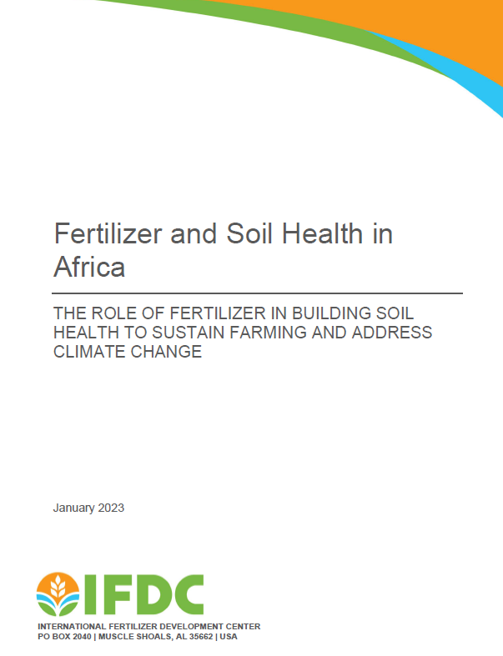















Fertilizer and Nutrient Management Strategies to Build Soil Health in African Agriculture
Prem S. Bindraban, Upendra Singh, Rob. J.J. Groot, Bernard Vanlauwe, Kido Kouassi, Patrice Annequin
November 2023

Slide 2
Soil Health
Slowly but steadily building up Soil Health in Africa

Slide 3
Soil Health
The overall well-being and capacity of a soil ecosystem to function effectively and sustainably. Encompasses various physical, chemical, and biological properties of the soil that contribute to its ability to:
Sustain optimal plant productivity,
        maintain/enhance environmental quality,
                and provide ecosystem services.
● Critical for addressing issues of food security, self-reliance, poverty reduction, etc
● Yield as a measurable indicator (in agronomic and economic terms)
● Critical for addressing issues of sustainability, production efficiencies, etc
● Input (nutrients, water) use efficiency as a measurable indicator (in agronomic and economic terms)
● Entails a large number of services, often related to carbon sequestration, regulation of water dynamics, biological diversity, erosion prevention, etc
● Carbon stocks and structural integrity as measurable indicators
Soil health as a public good!

Slide 4
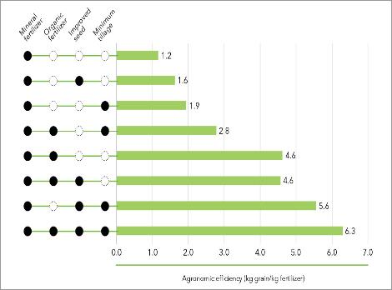
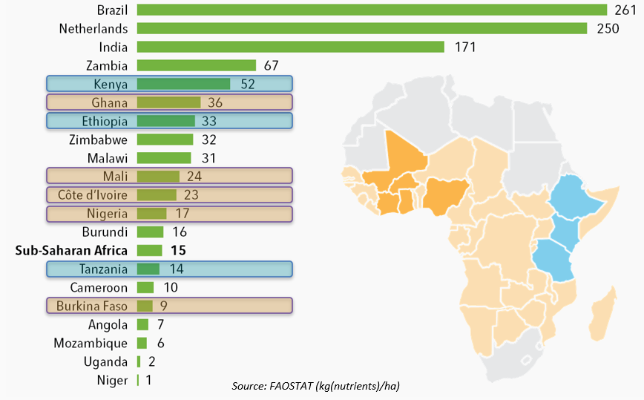
Economic Viability of Fertilizer Use
Agronomic Efficiency (kg grain/kg fertilizer
Availability of organic matter/fertilizer?
Source: Adzawla, W., Setsoafia, E. D., Setsoafia, E. D., Amoabeng-Nimako, S., Kwesie, B., Atakora, W. K., Camara, O., Jemo, M., & Bindraban, P. S. (2023). Fertilizer use efficiency and economic viability of fertilizer use by farmers in Ghana . IFDC FERARI Policy Brief No. 11.

Slide 5
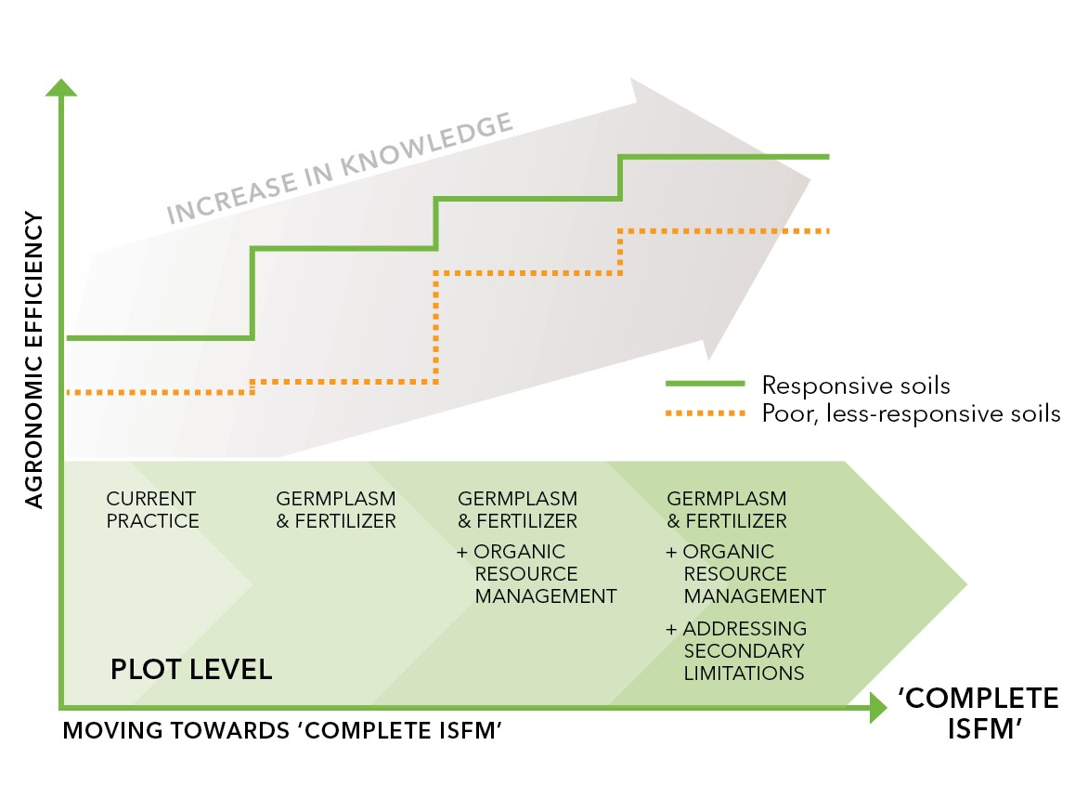
Integrated Soil Fertility Management
1. Apply fertilizer wisely (right time, place, source, and rate)
2. Use improved/adapted varieties (e.g., high yield, pest/disease resistant)
3. Combine fertilizer with organic inputs (e.g., crop residues, manure) or other complementary inputs (e.g., rhizobium inoculant for legumes)
4. Apply good agronomic practices (e.g., planting, weeding)
5. Address localized constraints (e.g, soil acidity, hardpans)

Slide 6
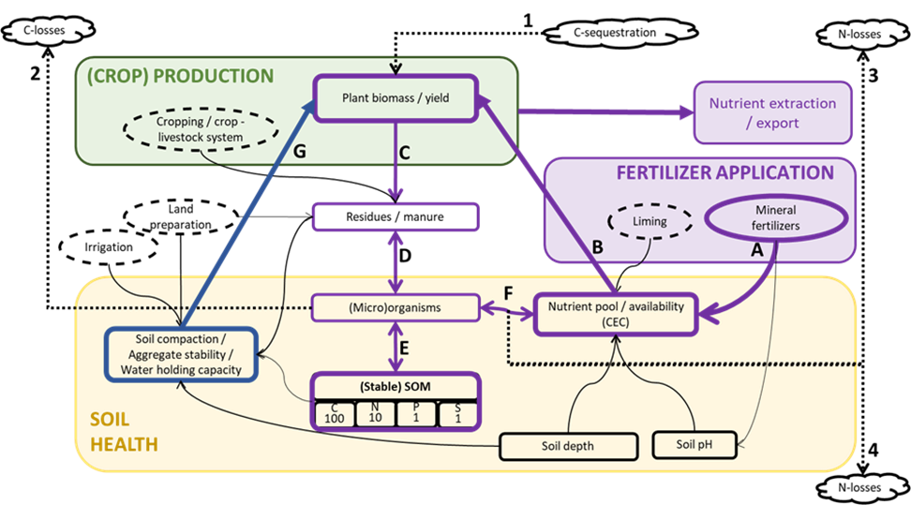
Fertilizer x crop production x soil health
Indirect route
Direct route
Bernard Vanlauwe, Tilahun Amede, André Bationo, Prem Bindraban, Henk Breman, Rob Groot et al., 2023. Fertilizer and Soil Health in Africa. The role of fertilizer in building soil health to sustain farming and address climate change. IFDC, January 2023.

Slide 7
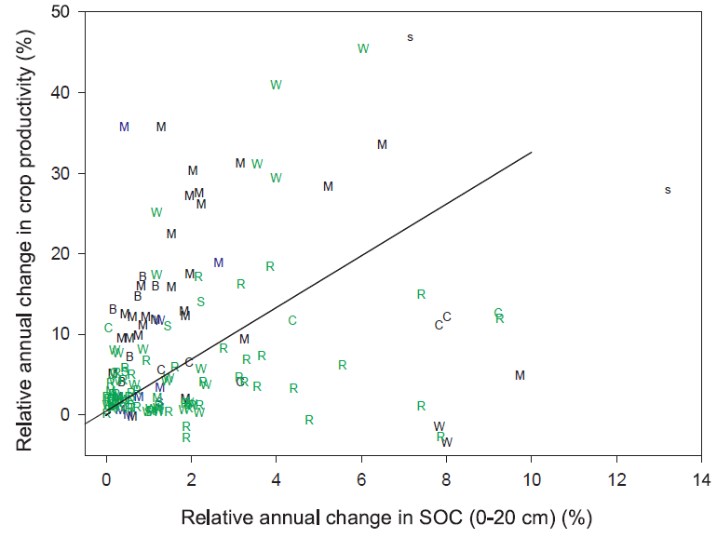
Crop yields vs soil organic carbon
→ Increasing crop yields results in increasing soil organic matter contents but this does not happen ‘automatically’
→ Despite scatter, on average, across studies in Africa, Asia and Latin America, a 1.3% annual increase in crop grain yields was associated with a 0.4% annual increase in soil organic carbon stocks.
Source: Soussana et al., 2019. Crop species: B, beans; C, cassava; M, maize; P, sweet potatoes; R, rice; S, soybean; s, sorghum; W, wheat. Field experiment regions: Africa (black); Asia (green); and Latin America (blue). The solid line is the standard major axis regression for all data points (n=151, P<0.012).

Slide 8
A CREDIBLE Action Plan to build Soil Health
Create awareness and incentive mechanisms (soil health, a public good)
Retain realism and patience (soil health is a ‘slow’ variable)
Define soil health and measure progress (address secondary issues)
Innovate and create efficiencies (R&D, digital, data science, sensors)
Bundle services (advisory services, climate, insurance, credit, market access)
Leverage earlier work and co-invest in space and time
Empower last-mile delivery agents (locally relevant, bundled services)

Slide 9
Building the policy and institutional environment for investments in soil health
The African Continent

Slide 10
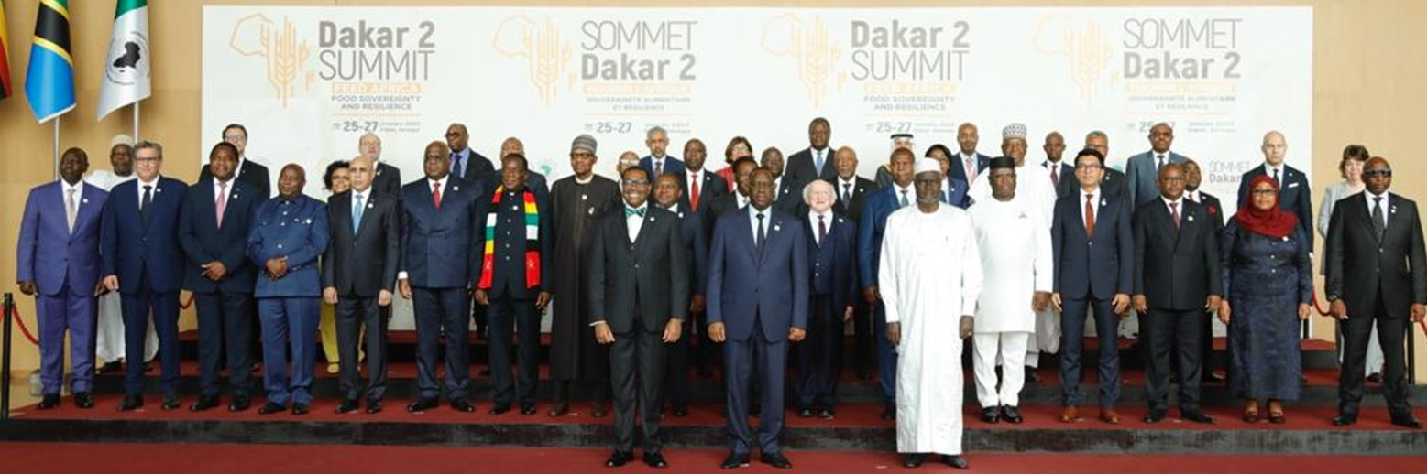
COMPACT – DAKAR-2 (Jan 25-27,2023)
WE the Heads of State and Government of 34 African countries…AGREE
that it is time for Africa to feed itself and fully unlock its agriculture potential…

Slide 11

Africa Fertilizer and Soil Health Summit
Development of a 10-year action plan 2023-2033

Slide 12
Four Major Areas of Intervention
Outcome 1: Improved policies, investments, financing and markets for fertilizer and soil health management
1.1: Improving the policy environment for efficient fertilizer production and use and for sustainable land management
1.2: Improved financing and investment opportunities
Outcome 2: Improved access to and affordability of organic and inorganic fertilizers
2.1: Increase national production and distribution and strengthen research on organic and inorganic fertilizers
2.2: Improving intra-regional fertilizer trade
Outcome 3: Increased efficiency, resilience and sustainable use of inorganic and organic fertilizers and soil health and sustainable soil management interventions
3.1: Development of recommendations targeted to specific crops, soils and climatic conditions
3.2: The efficiency of agronomic fertilizer use is increased to optimal levels
3.3: Creation and accessibility of a digital soil database.
Outcome 4: Institutional and human capacity for sustainable fertilizer and soil health management is strengthened
4.1: Development and promotion of locally relevant fertilizer and soil health technologies
4.2: Soil testing services available and affordable to a large number of smallholder farmers
4.3: Establish regional knowledge exchange networks
4.4: Improved delivery systems for last-mile soil health solutions

Slide 13
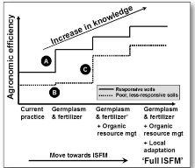
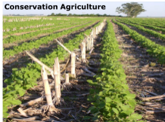
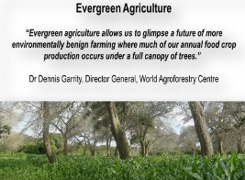
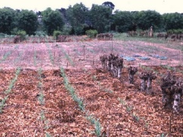
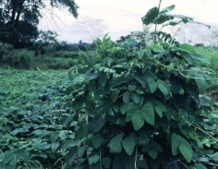
Incentives created through profitable value chains
❹
A
Time
High
Desired
status
❺
❼
❷
❸
❶
Productivity
❻
B
C
Initial
status
Low
Initial
status
Unless incentive schemes (e.g. payment for environmental services)
R-o-I = 0
Low
Soil health
High

Slide 14
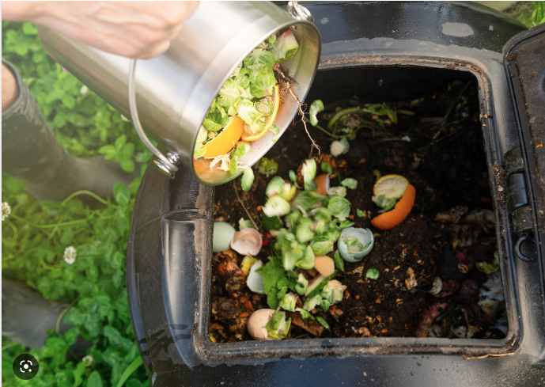
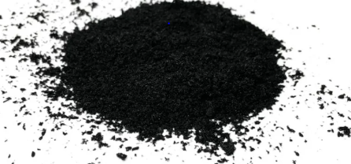
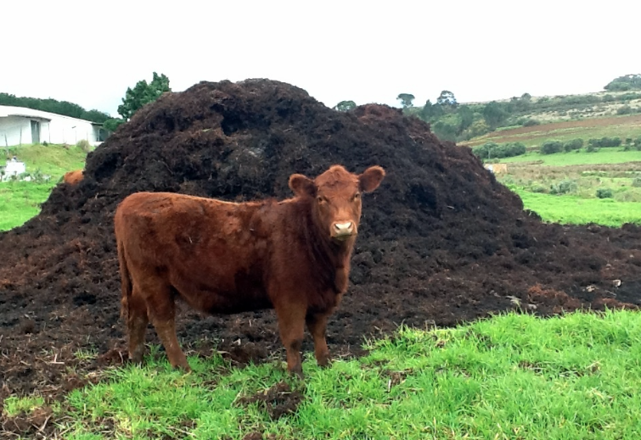
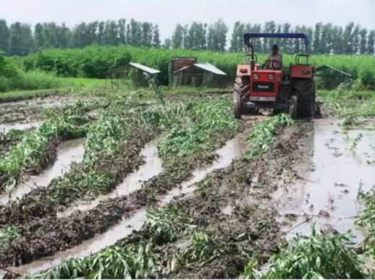
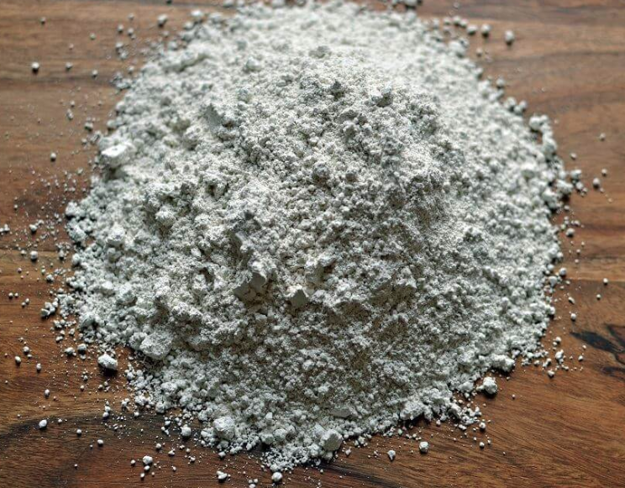
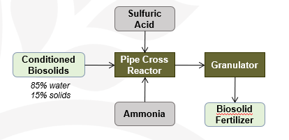
Organic Fortification: Combination of organic and chemical fertilizers
Compost
Biochar
Manure
Green Manure
Bonemeal/ Ash
Process:
Recycled waste/manure processed into amino acids and organic compounds
Used as a cooling water substitute in granular ammonium sulphate production
Other nutrients added as desired
Commercially available
Benefits:
Value-addition
10-15% higher yield
Reduced N loss
Carbon, micronutrients

Slide 15
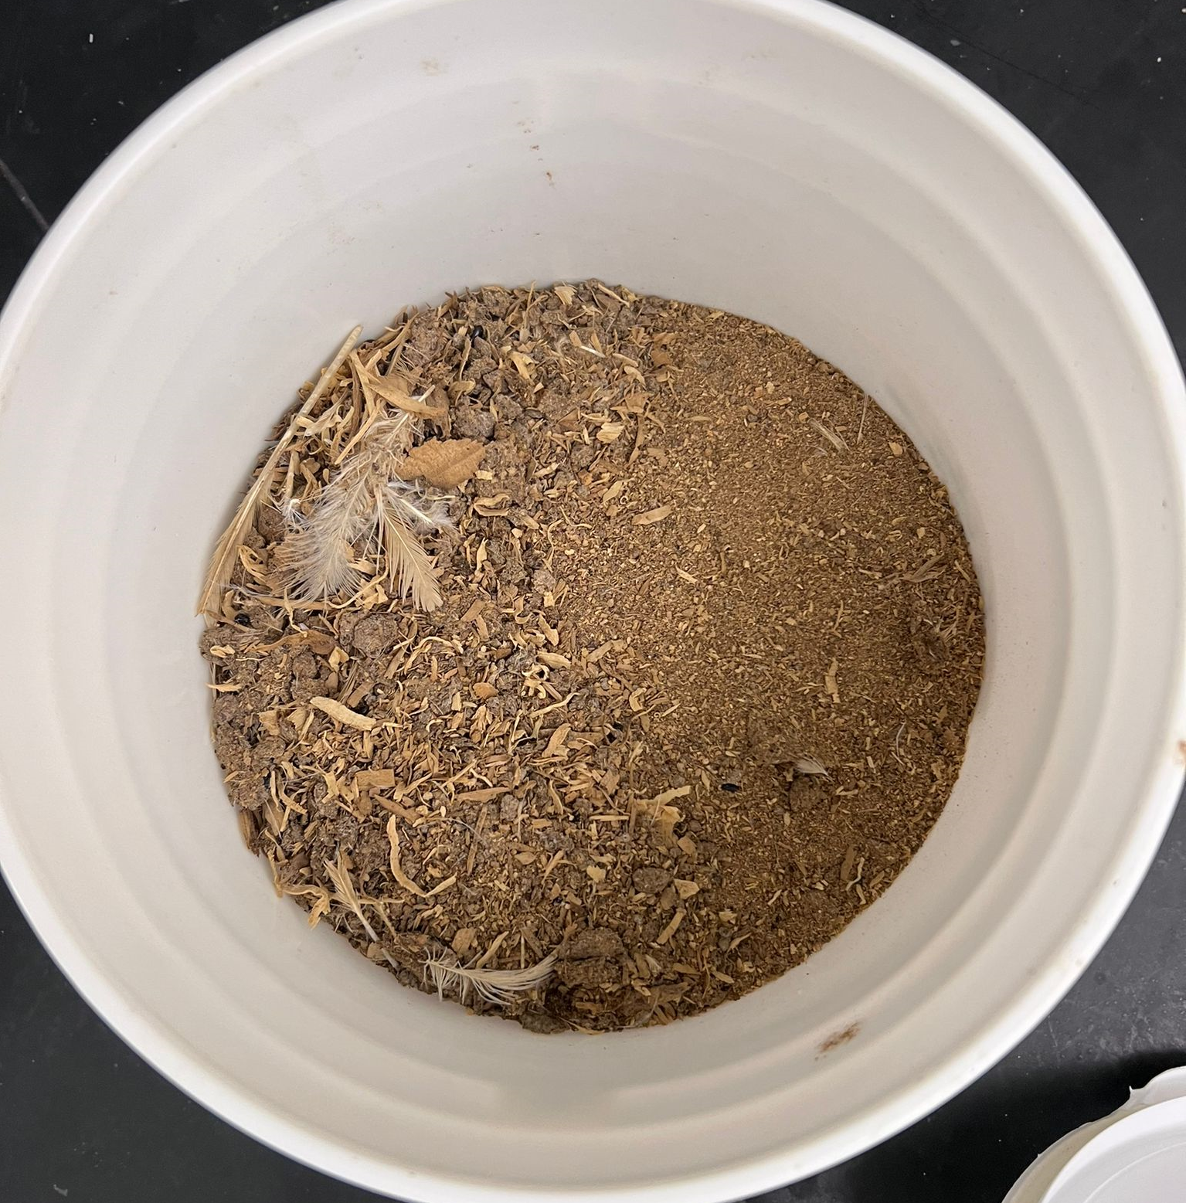
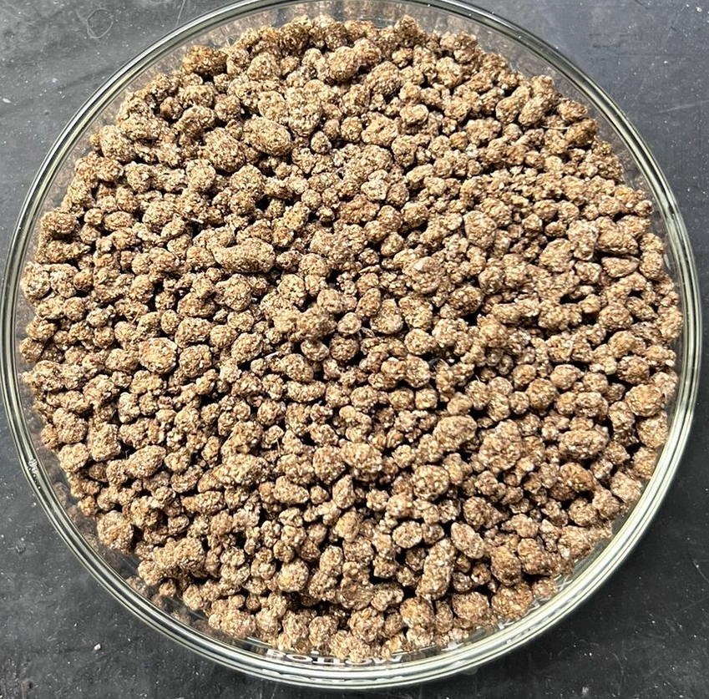
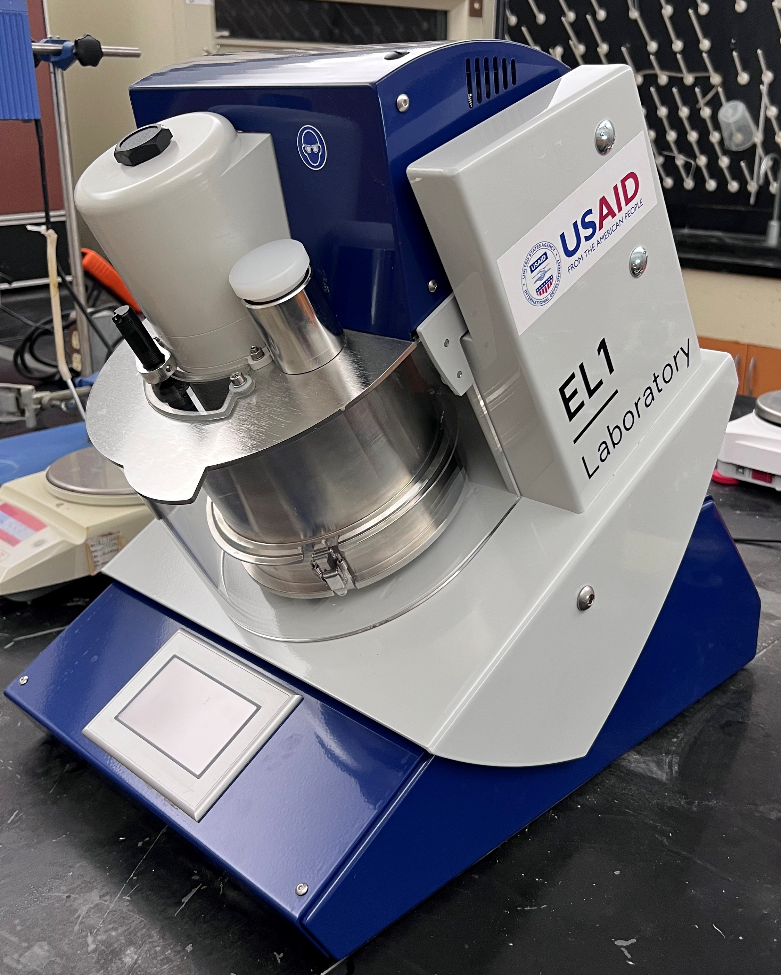
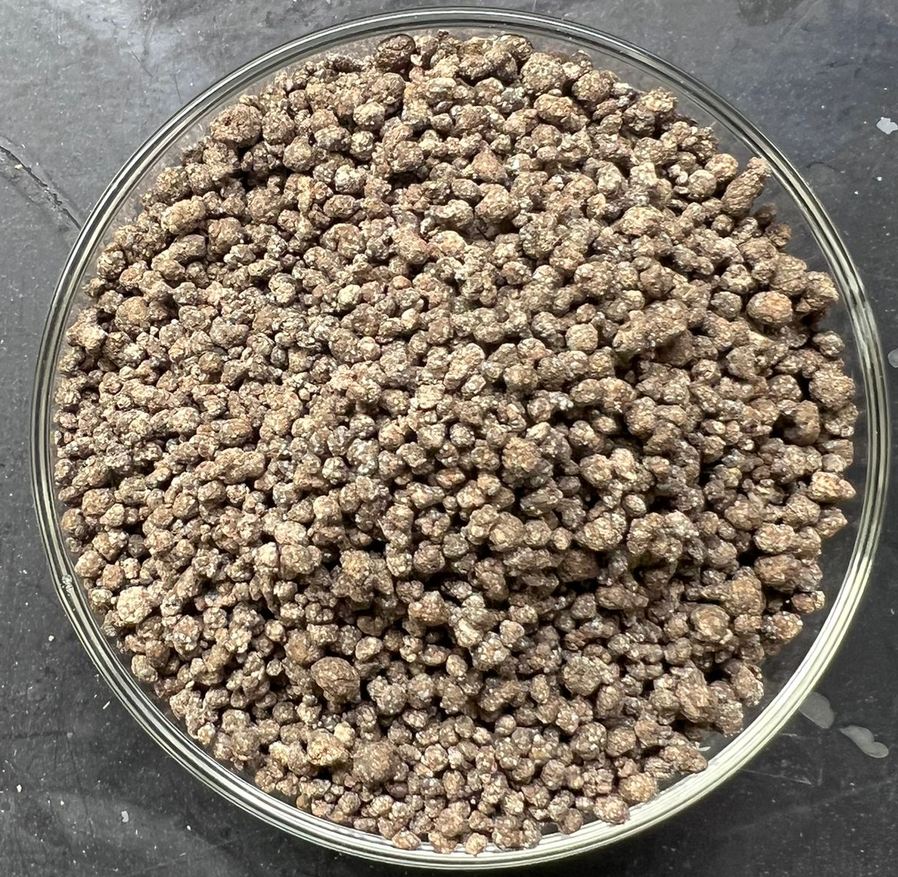
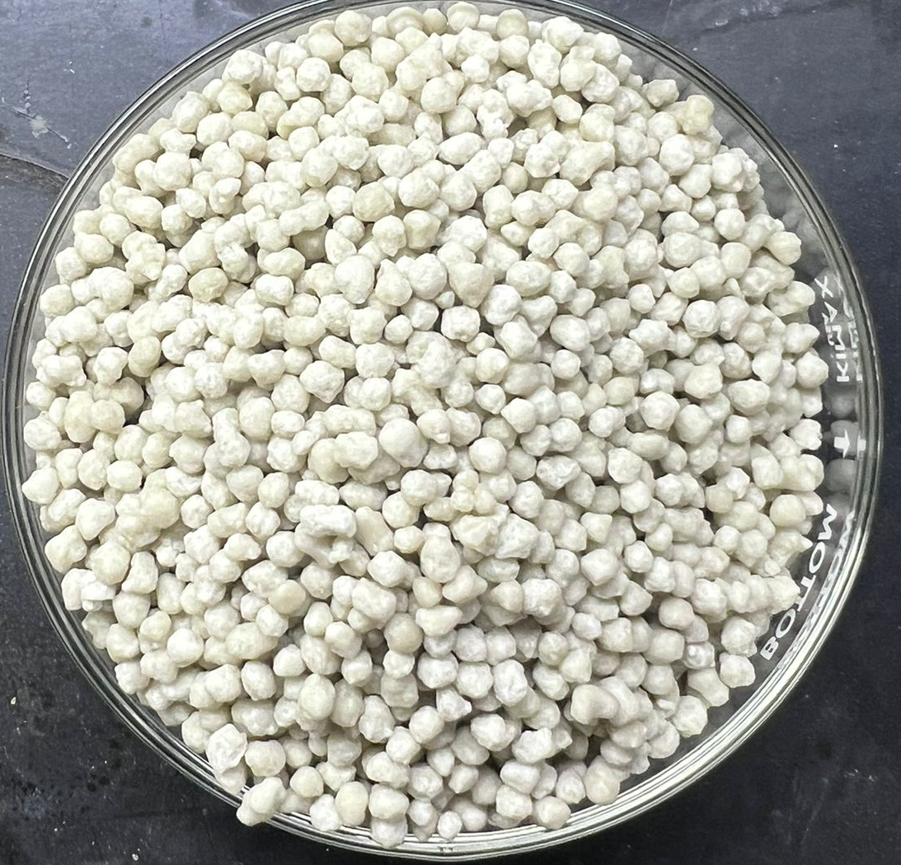
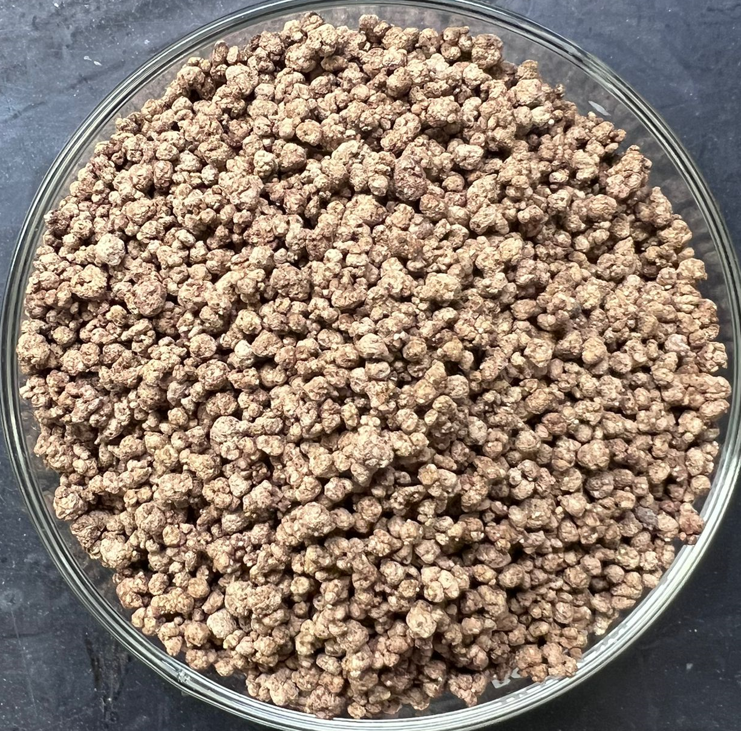
Organo-Mineral Fertilizer: Fertilize 4 Life
18:04:00 + 65%OM
Chicken Litter
Fo97
18:05:00 + 50%OM
+
Fo100
18:04:00 + 65%OM
Intensive Mixer
Dry mixture
Dry dispersing
Granulation
Max 1 kg
NPK Fertilizer
Fo101

Slide 16
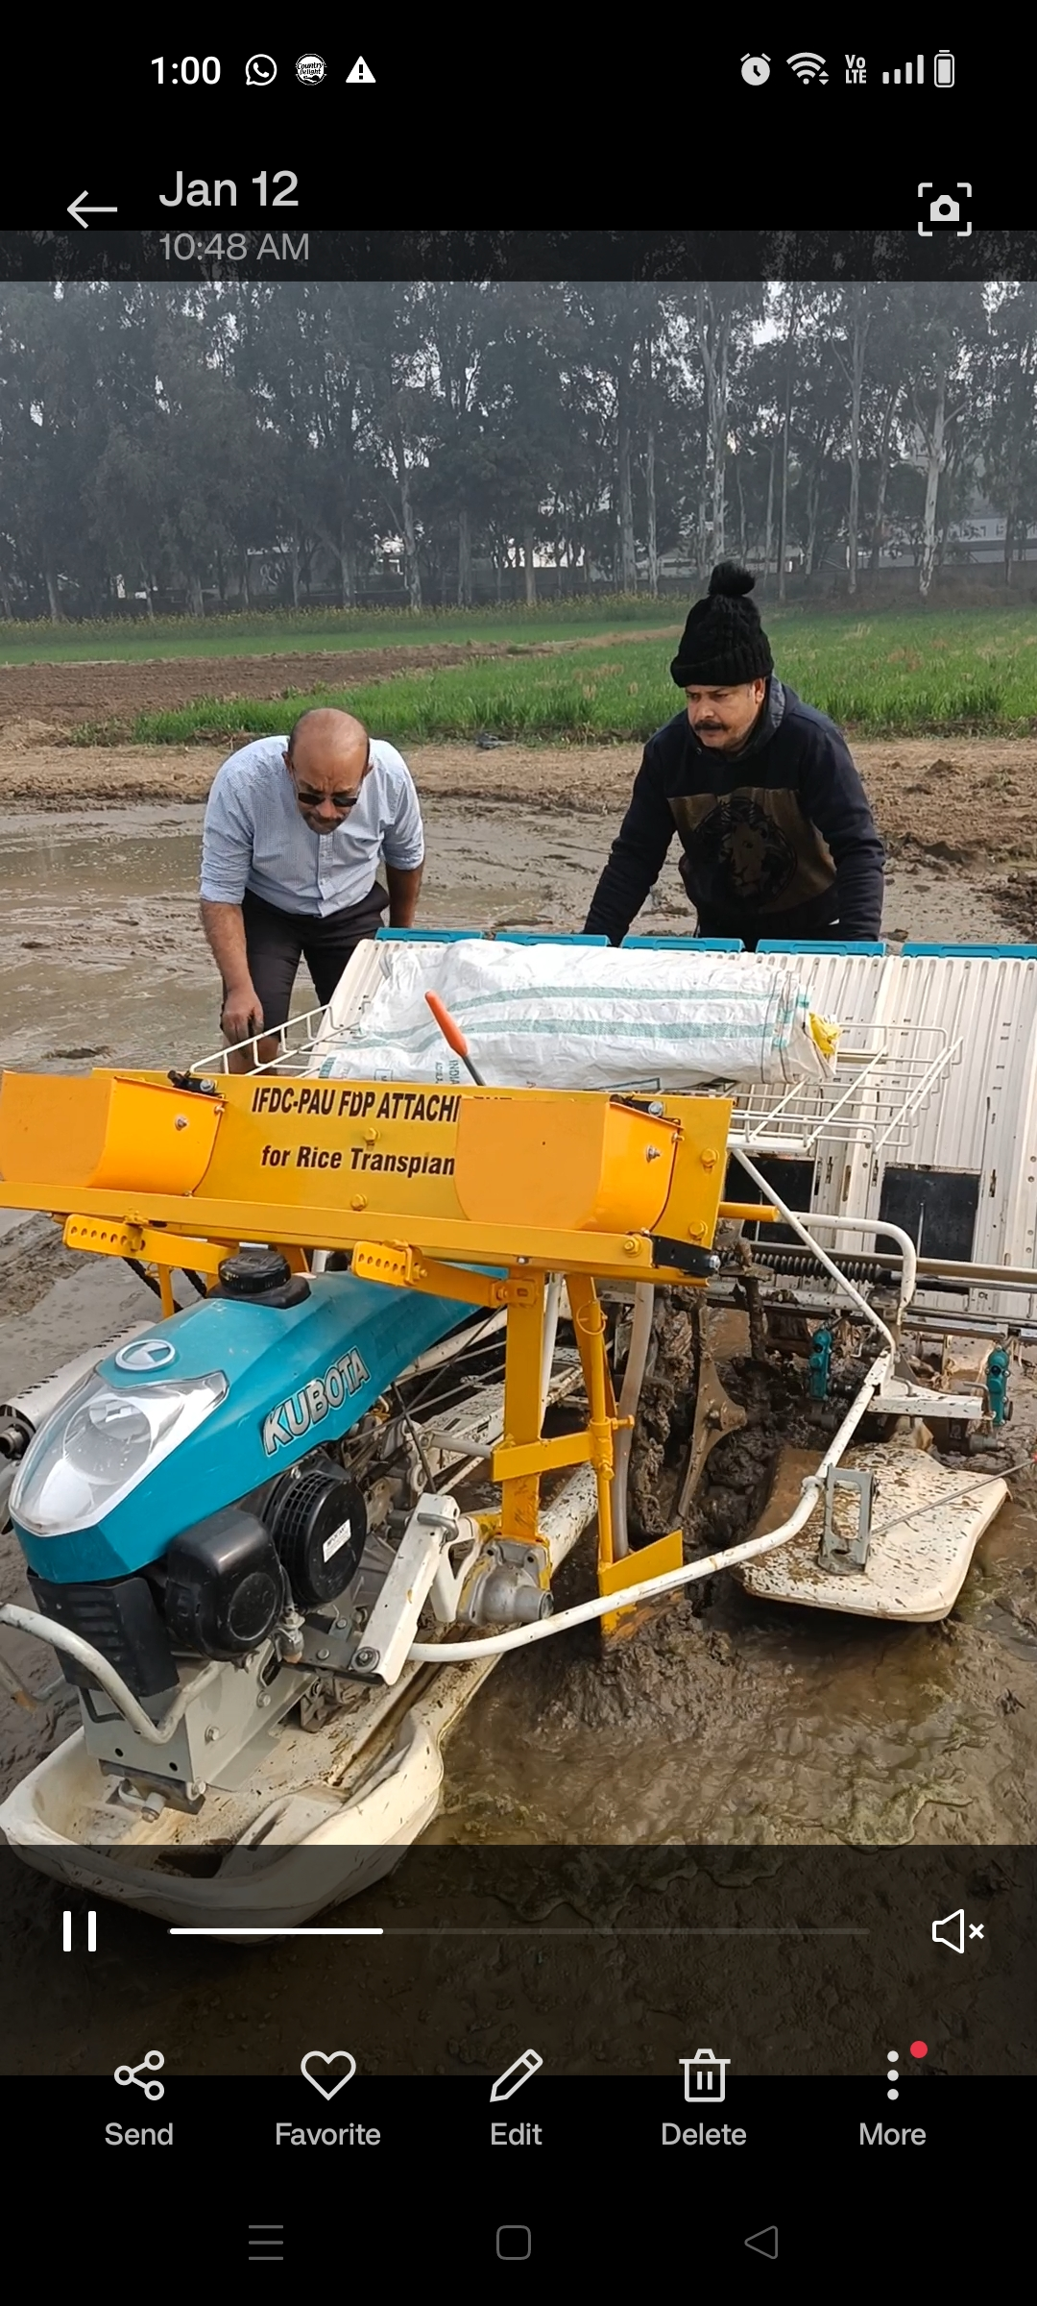
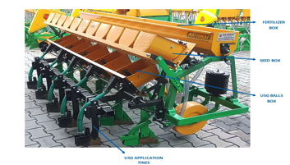
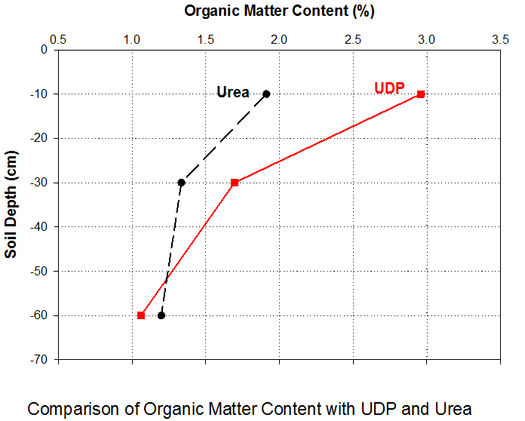
Mechanized Fertilizer Deep Placement : More with Less + Customized Balanced Fertilization
Productivity gains: 15-20% yield increase
Less urea use: 20-35% less
GHG savings from less use of urea
Lower N losses: runoff, volatilization (negligible)
Lower nitrous oxide emission (GHG)
Energy-savings: one-time application
Suitable for adverse environments
Soil organic matter buildup, CO₂ capture/fertilization

Slide 17
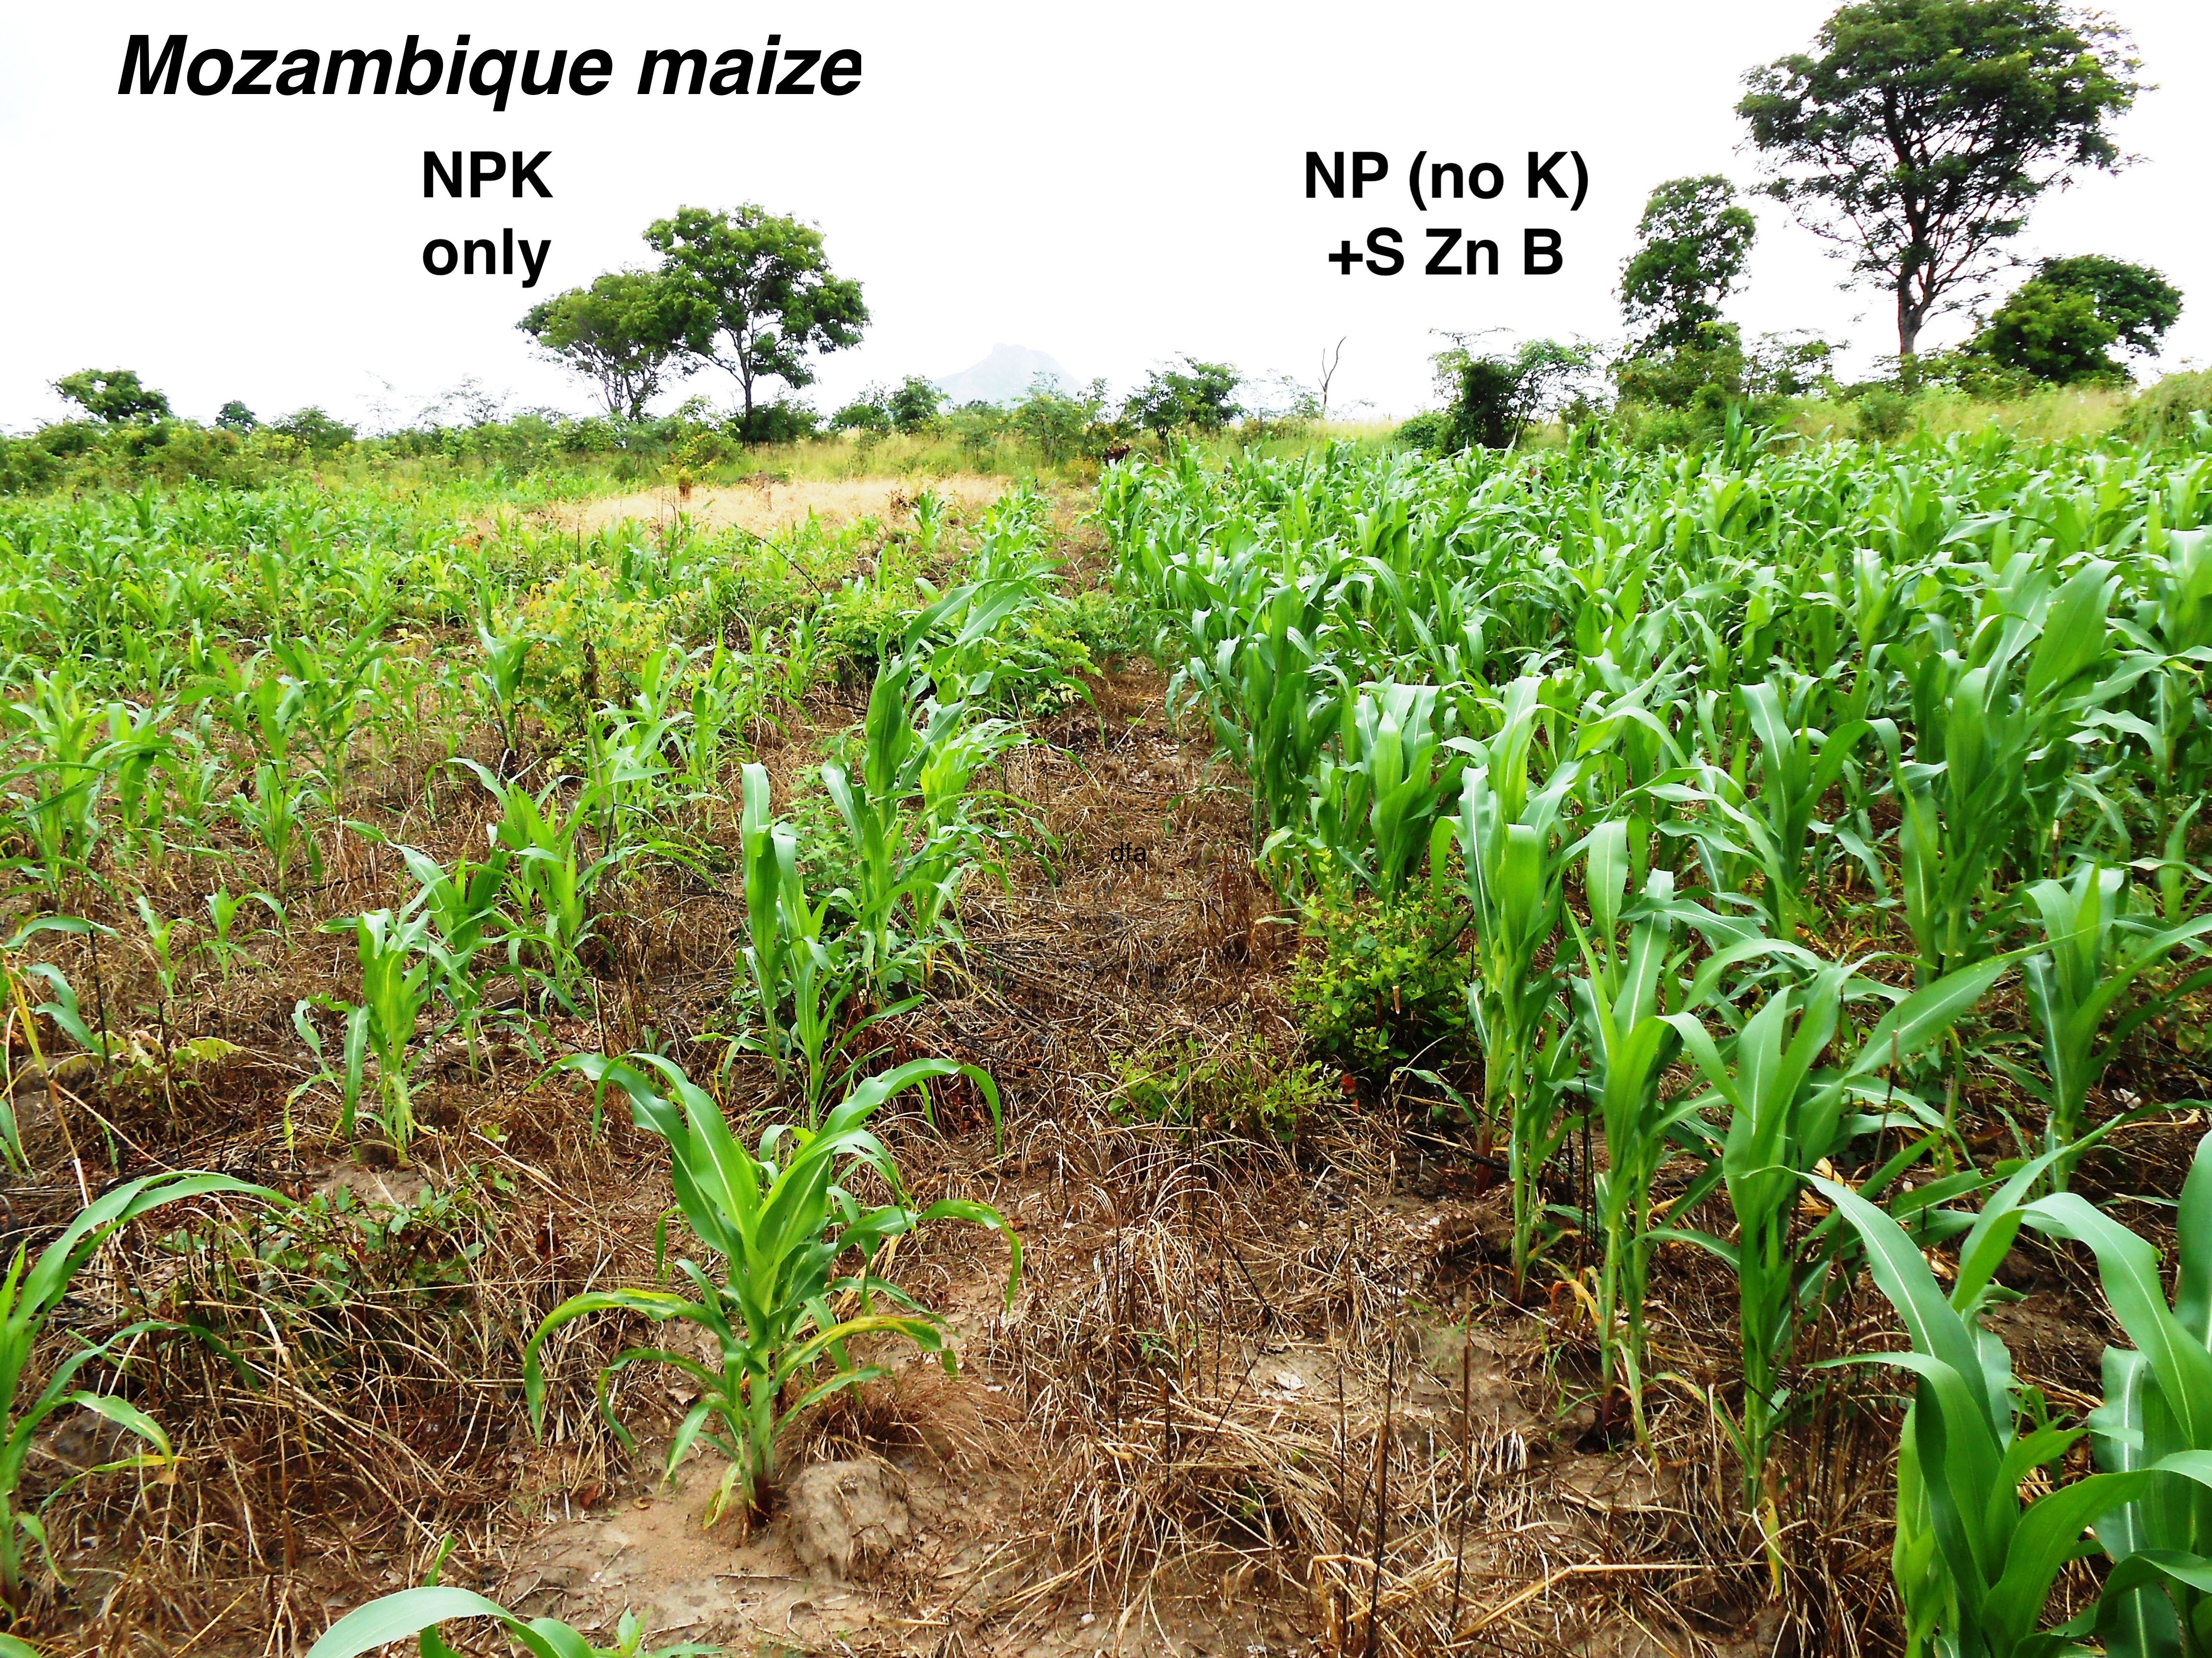
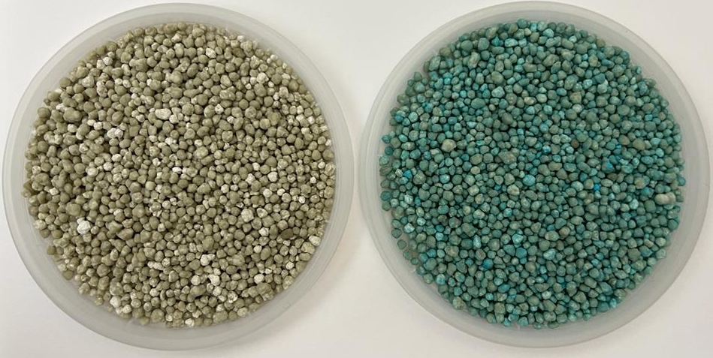
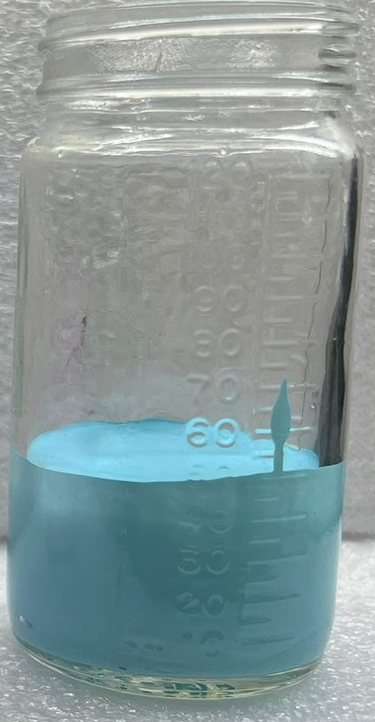
Micronutrient Fortification: Balanced Fertilization
Micronutrients Dispersion
FERTILIZER
FERTILIZER
Dispersion
+
Micronutrients (Zinc)
Micronutrients
FERTILIZER
MAP
MAP + Dispersion with Micronutrients
Notes:
Dispersion with ZnO and Zinc EDTA. Water based.

Slide 18

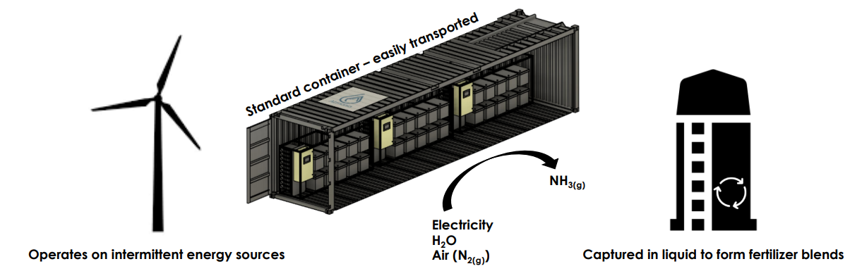


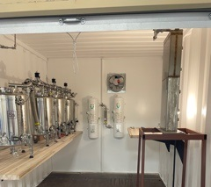
Decarbonized and Decentralized N Fertilizers
Renewable energy source
Electrolysis
Atmonia (Iceland): NH₃ to fertilizer blends –AH-B
Yara, Talus Renewables: H-B with renewable energy for NH₃
Plasma Arc
Nitricity (California): nitric acid
Biological N fixation
Pivot-Bio www.pivotbio.com Kula-Bio www.kulabio.com

Slide 19
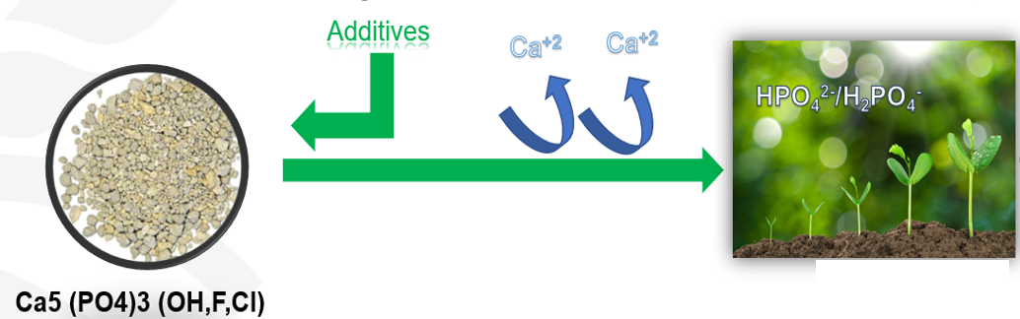
Decentralized P Fertilizer Production
Rationale
Additives
Starter-effect: MAP, DAP.
Bio-organic acid treatments (ammonium gluconate, organic and biological acid-treated unreactive PRs
Minerals (Ca²⁺ sequestration)

Slide 20
A CREDIBLE Action Plan to build Soil Health
Create awareness and incentive mechanisms (soil health, a public good)
Retain realism and patience (soil health is a ‘slow’ variable)
Define soil health and measure progress (address secondary issues)
Innovate and create efficiencies (R&D, digital, data science, sensors)
Bundle services (advisory services, climate, insurance, credit, market access)
Leverage earlier work and co-invest in space and time
Empower last-mile delivery agents (locally relevant, bundled services)

Slide 21
Thank you
Contact person: usingh@ifdc.org
Contact person: pbindraban@ifdc.org

