Slide 1
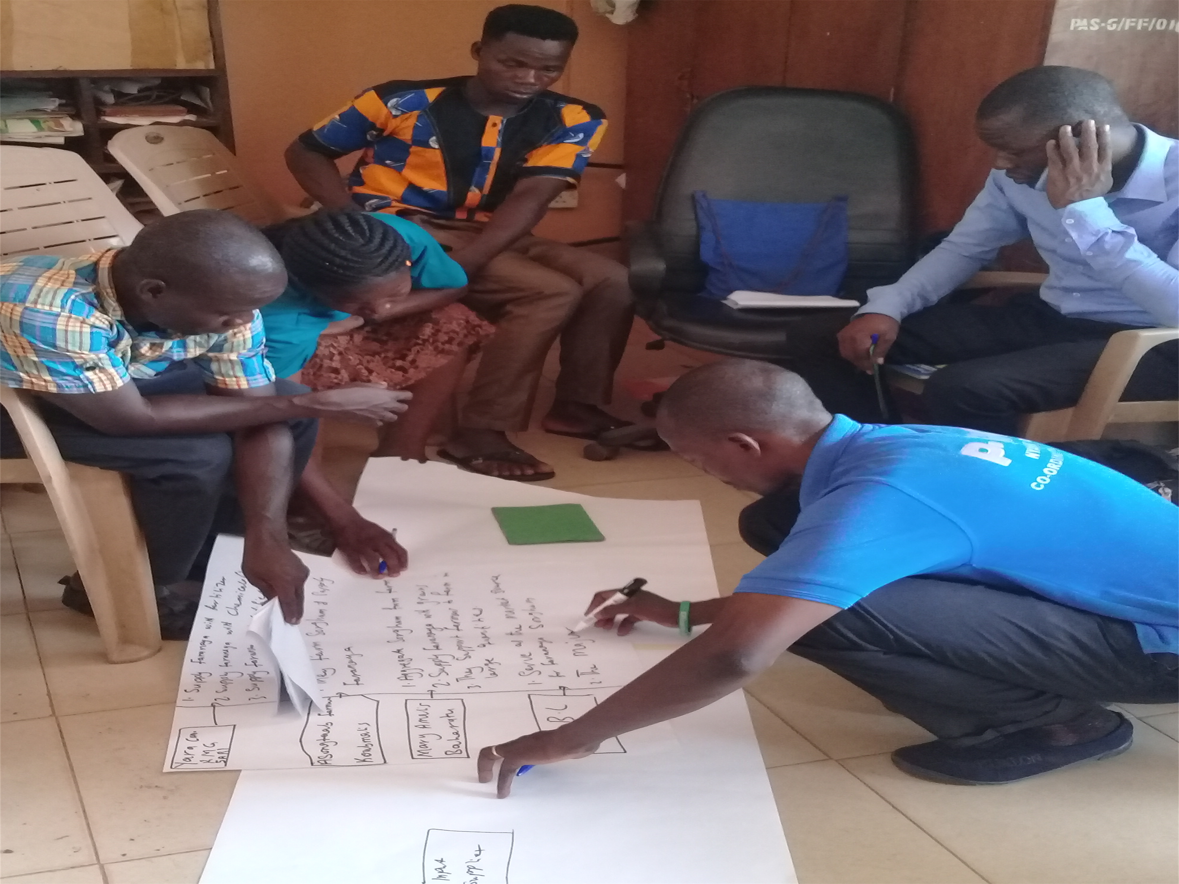
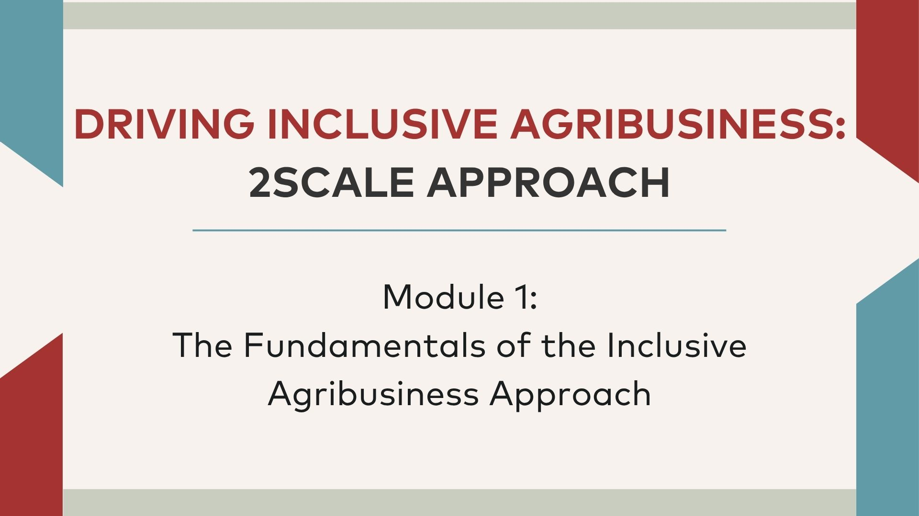
Driving Inclusive Agribusiness : 2SCALE Approach
Module 1: The Fundamentals of the Inclusive Agribusiness Approach

Slide 2
MODULE 1: Outline
About 2SCALE
Session 1 : How to identify and assess an inclusive and commercially viable business model
Session 2 : Key pillars and principles in establishing PPPs
Session 3 : Steps in setting up Partnerships
Session 4 : Key thematic areas needed for promoting inclusive agribusiness models

Slide 3
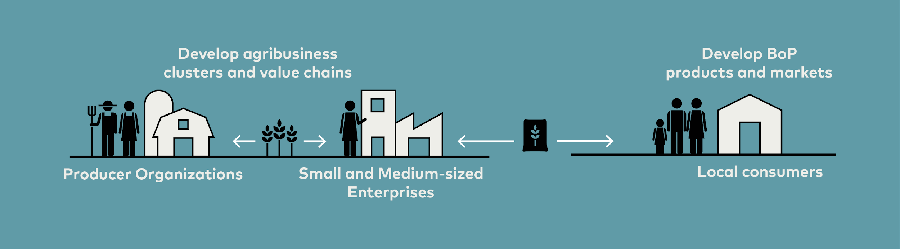
What is 2SCALE about?
TERMS OF INCLUSION
The Approach Improves the:
Terms on which smallholder farmers supply markets
Opportunities for women and youth to find employment
Terms on which low-income consumers in rural and peri-urban markets access nutritious and healthy food.
2SCALE is an incubator and accelerator program that manages a portfolio of public private partnerships (PPPs) for inclusive businesses in agri-food sectors and industries.
2SCALE focuses on establishing agribusiness clusters around local business champions such as entrepreneurial producer organizations or SMEs that trade in or process farmer produce. Our program supports these champions to develop BoP products and creating the requisite markets linkages to ensure affordable and nutritious food products are accessible.

Slide 4

SESSION 1
How to identify and assess an inclusive and commercially viable business model.

Slide 5
What is inclusive agribusiness: Agribusiness vs inclusive agribusiness
“Agribusiness refers to the various businesses involved in food and fiber production (including farming), supply of seed supply, agrichemicals, farm machinery, wholesale and distribution, processing, marketing, and retail sales."
“Inclusive agribusiness is about deliberately shaping core business processes and values of agrifood sectors so that they address the needs of low-income disempowered parties such as SHFs, workers or labor service providers, creating value for these groups and the company.”

Slide 6
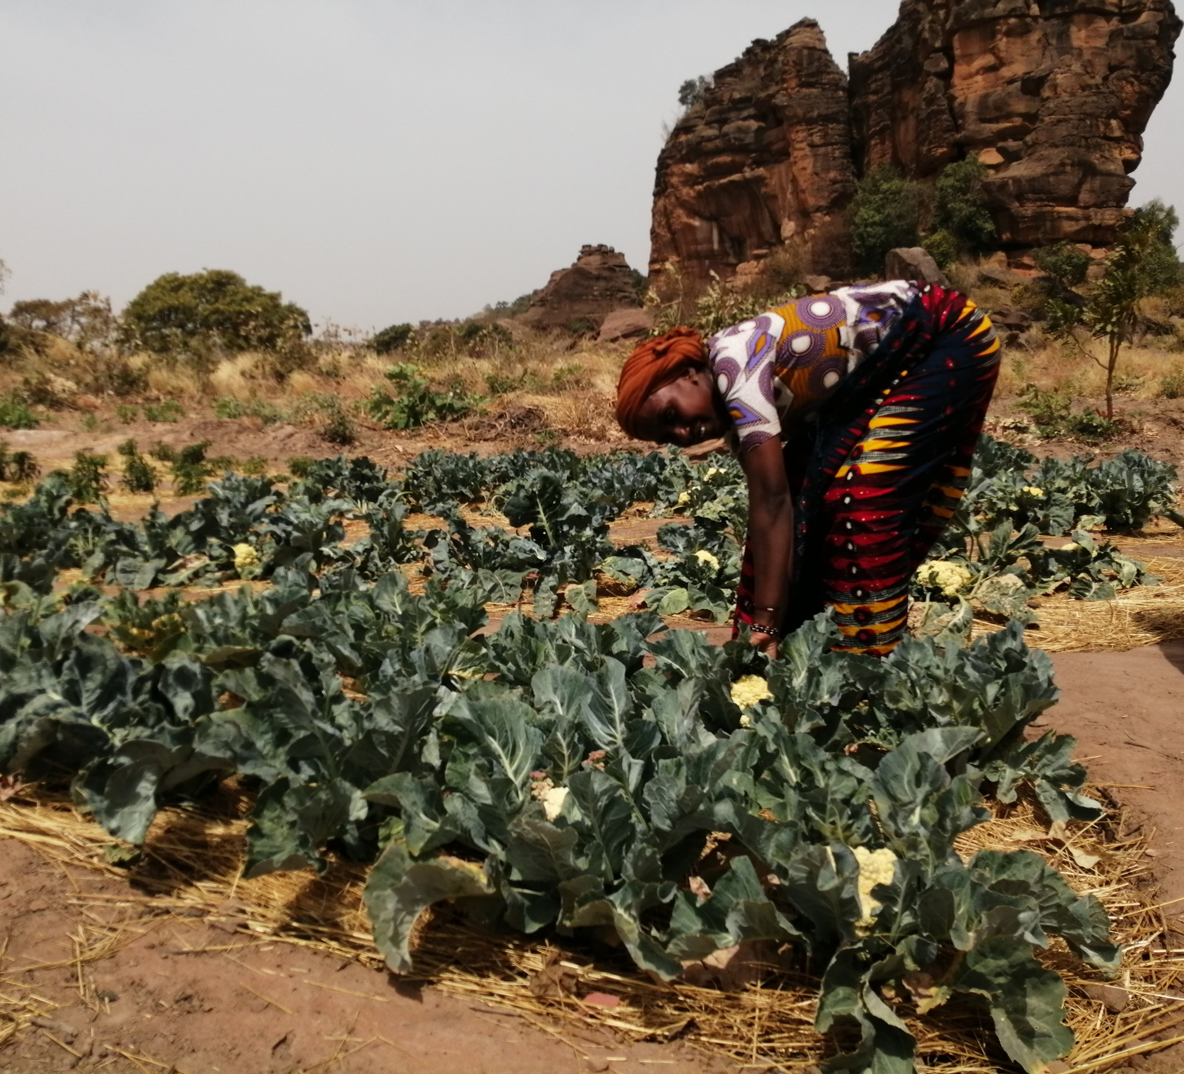
What is inclusive agribusiness ?
Work with low income communities (“grass roots actors”) – who are involved in value chains as suppliers of inputs and services, farmers, processors, traders and consumers.
Contribute intentionally to poverty alleviation – without losing sight of services and businesses needed to generate profit.
No quick fixes – Addressing the riskiness of markets/ value chain integration by strengthening of local networks (ABC) to capacitate and reduce dependency of smallholder farmers.
Going the extra mile to contribute to food and nutrition security – To effectively reach African food insecure BoP consumers.
Nurtures a strong win-win relations – with smallholder farmers and micro-enterprises on the production side; whilst profitably selling nutritious food products to lower-income

Slide 7
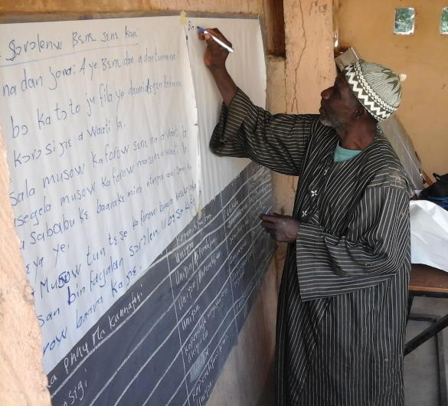
2SCALE employed Two Steps
1. Mobilizing Inclusive Business ideas
And
2. Screening of the Inclusive Business ideas mobilized
To identify and assess an inclusive and commercially viable business model,

Slide 8
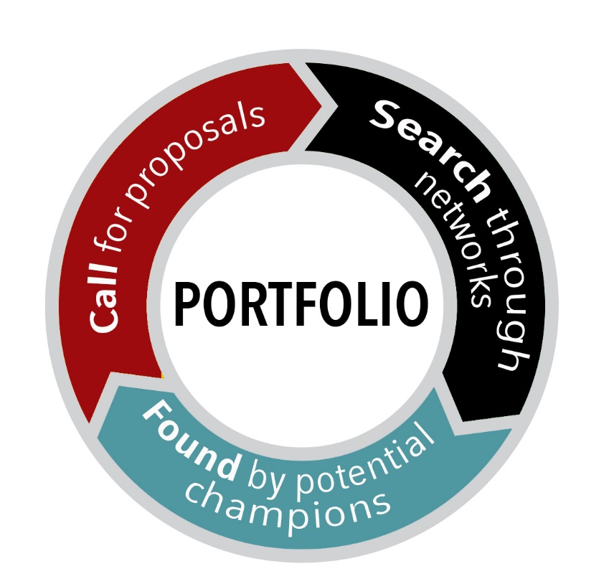
Step 1: Mobilizing the Inclusive Business Idea
2SCALE used three complementary pathways to identify potential partners and mobilize inclusive business ideas. The call, the search and the found methods.
A business idea is written by a potential business champion with the goal of providing a compelling story about their inclusive business model. The business idea should contain at least the following elements in the champions own words:
Details of the private organization (potential partner) – Include information on the business registration status, history, geographical presence, products or services offered, team, shareholders and business governance.
Description of the business model – Elements of the business model canvas can be included: End-customers, Value proposition(s), Marketing channel choices, Key partners, activities, resources (available/ required).
Identification of impact domains –The social impacts it expects to contribute to through its business model.
Indication of relevant stakeholders – Mention major stakeholders with which it has business relationships or would like to develop new linkages to strengthen its business.
Explanation of the reason to request support from 2SCALE – Explain why it requires a development partners support, and the form its own contributions.

Slide 9
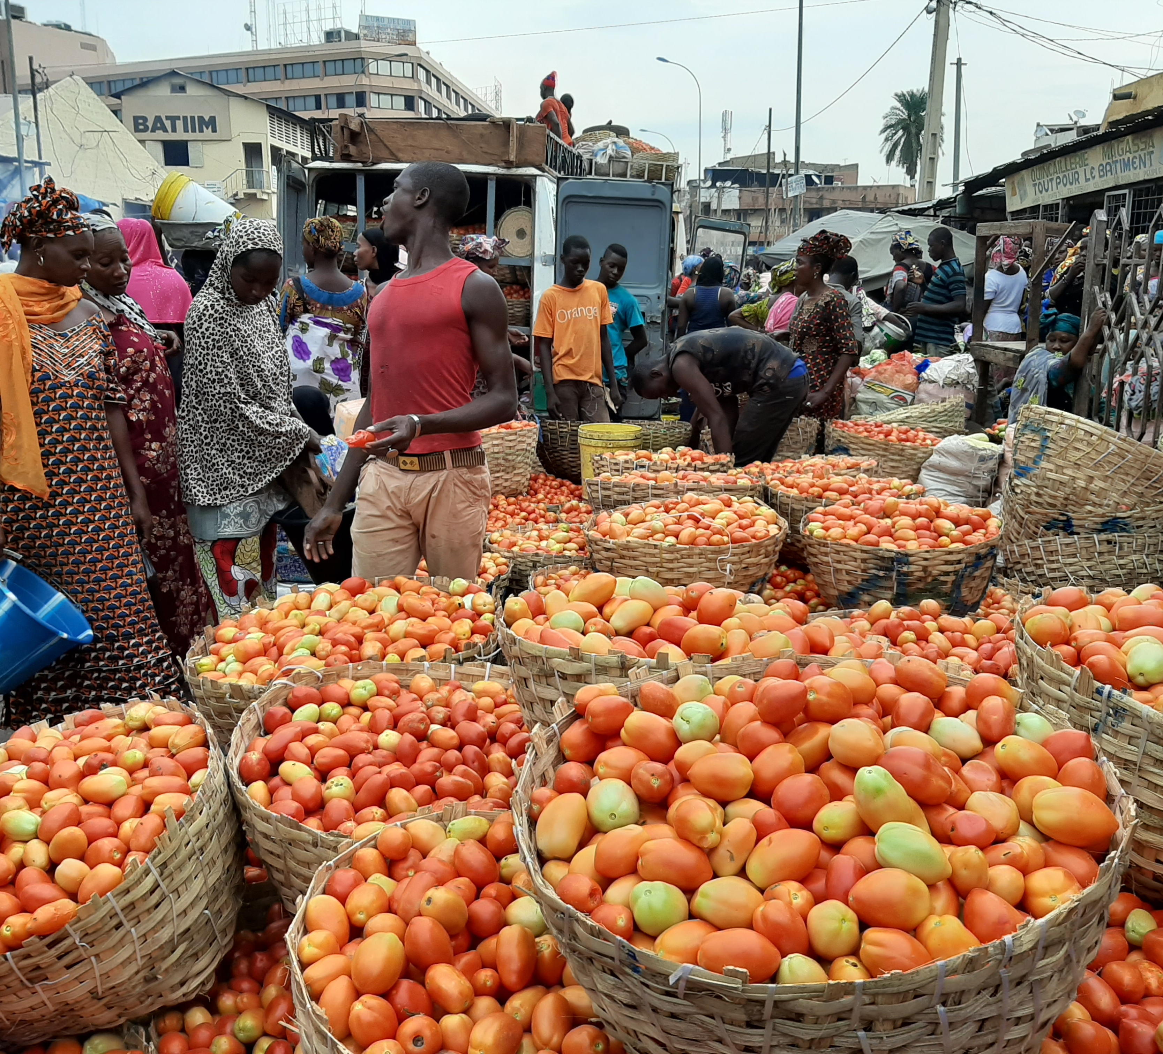
Step 2: Screening of the Inclusive Business Idea
The screening step mainly intends to separate qualifying inclusive business ideas from less-interesting or opportunistic ones. It is conducted by the program field team using a screening form and consists of a rapid assessment focusing on the following elements:
Desk-study: Does the business idea fit in the portfolio development agenda of program, in terms of target market/ industry and geographical choices etc.,,,
Desk-study: Business champion – Transparent ownership and management structure? AND Compelling track-record in core business, and no legal or financial issues?
Field assessment: Business champion’s 4C – the character in terms of CSR, competence, capital (social) and capital financial.
Field assessment: Inclusive business idea assess Competitiveness, Inclusiveness, Cost-sharing commitment, Policy alignment, Environmental impact and risks, Innovativeness and Additionality considerations.
The screening should be complemented by detailing business contribution to the Program targets for impact indicators in the focus country. Examples include farmers, Bops, SMEs/MSMES, women and innovations etc..
Notes:
NB: If 1 & 2 are okay, the next elements follow, otherwise the business idea is rejected.
NB: Results of 3 & 4 should be positive for all listed sub-elements and compare well to competitor ideas, for admission to the next step.

Slide 10
Further Reading Materials
2SCALE Academy_Podcast_Adodo_on_inclusiven.mp3
2SCALE Understanding of Inclusive Agribusiness_Location 2SCALE Academy
Replication Case: Enhancing Pastoralist Organizational Development to Tap into New Business Opportunities
CHAPTER 1 and 5_2SCALE BOOK_BUSINESS AS UNUSUAL

Slide 11
Session 2-
Key pillars and principles in establishing PPPs

Slide 12
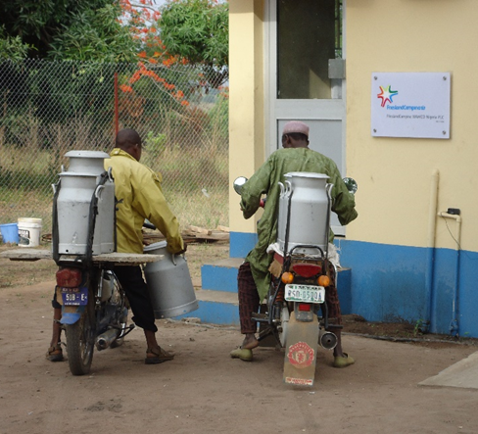
Why Partnerships ?
2SCALE uses the public private partnership (PPP) development approach for the incubation and acceleration of inclusive (agri)business models to ensure food and nutrition security, sustainable and inclusive economic growth. These PPPs :
Are not an objective per se, but a means to achieve the program’s goal, they serve like an umbrella under which the goals are achieved.
Focus on inclusive models in food markets are also referred to as “inclusive agribusiness PPPs”, to distinguish them from “supportive partnerships” that focus on a specific innovation and for which the development process is slightly different.
Are anchors on formation and development of ABC at the grassroot level and extends to downstream in the value chain and reaches the base of the pyramid (BoP) consumers in the low-income market.
are vital to mobilize co-investment and co-innovation along food and supply chains. Led by the business champions, 2SCALE's partnerships generate strategies and action plans to improve food system efficiencies, expand agricultural trade and boost food & nutrition security.
open an array of opportunities to connect farmers and consumers in a way that food & nutrition security is enhanced and the foundations for inclusive economic growth in food subsectors can be built and sustained.

Slide 13
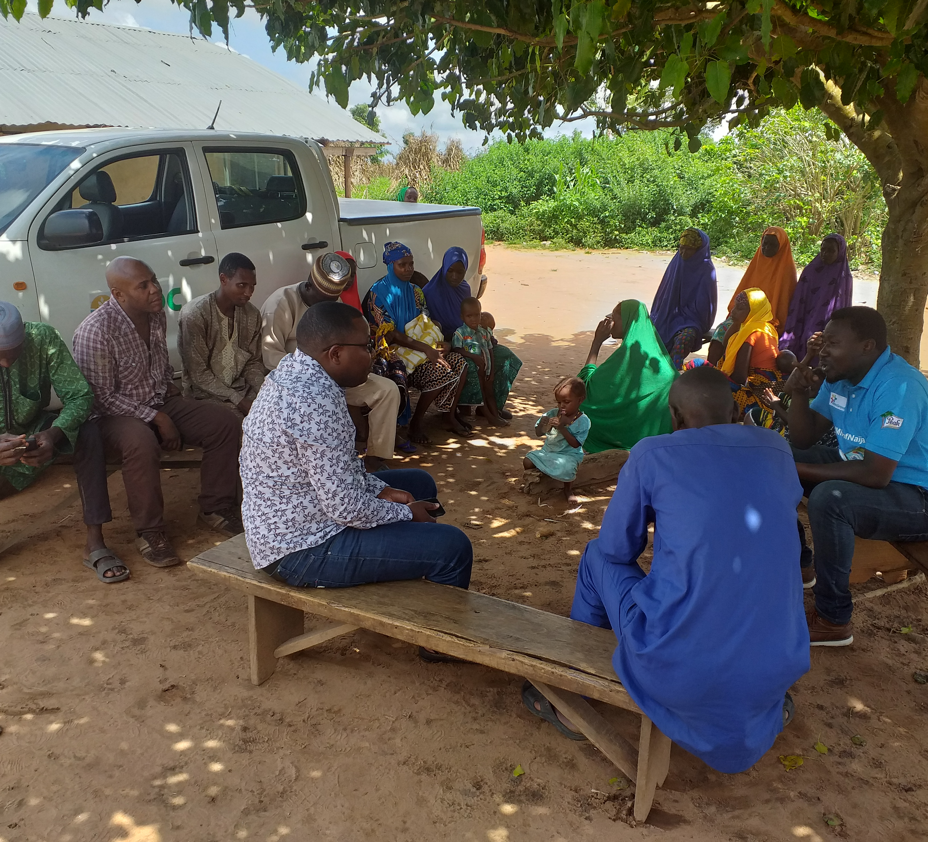
2SCALE’s PPPs are guided by the following five principles:​
  Leadership for inclusive change​: The partnership must be driven by a private enterprise (SME or PO) committed to inclusive change and to make inclusiveness part of the business model.
  Focus on concrete food value chain systems​: The partnership should be targeting specific local or regional food markets, value chain and agribusiness clusters.
  Additionality of the partnership​: Both Input additionality: the private partners are unable to self-finance the activities of the partnership.​ Development additionality: the partnership should generate development results​
  Leverage by the private partner​ : The private partner(s) should be ready to leverage the resources invested by 2SCALE to develop inclusive business strategies.
  Scalability of business models​: The partnership should have strong anticipated potential for scaling (e.g. by serving much larger markets, or through the replication of critical elements of the partnership model elsewhere).​
The Five Principles of a PPP

Slide 14

The Relevance of 2SCALE Approach
No upfront (“expert” designs) solutions – Support to local businesses committed to inclusive change and proposing their own homegrown solutions.
No quick fixes – Addressing the riskiness of markets/ value chain integration by strengthening of local networks (ABC) to capacitate and reduce dependency of smallholder farmers.
Going the extra mile – To effectively reach African food insecure BoP consumers.
Replication of partnerships and scaling – of inclusive business models in target food industries to address sector- / system-wide-institutional barriers
Technical Expertise - The 2SCALE Consortium (IFDC, Bopinc, and SNV) each bring to the table valuable sector specific expertise that jointly contributes to achievement of the desired program objectives.

Slide 15
4 Pillars of the 2SCALE approach
Championship: 2SCALE worked with a lead private business committed to develop inclusiveness, called business champions.
Agribusiness clusters and inclusive supply chain arrangements: The emphasis on local networks empowers farmers in three areas: linkages toother actors, strengthen collective actions from the grassroots and bargaining power of the farmers and local actors.
BoP markets: By fostering partnerships and value chains that target specifically BoP consumers, 2SCALE adds a new range of opportunities to capture market and entrepreneurial potential, to create new jobs and to involve women and youth (for instance in food processing, marketing and last-mile distribution).
Enabling business environments, including access to finance and information: 2SCALE aims to promote system-wide changes in support of fairer competitive playing fields and enabling partners (and other businesses) to conceptualize, implement and scale inclusive business models. Only bottlenecks that are seen by the partnership as both critical and actionable are addressed.

Slide 16
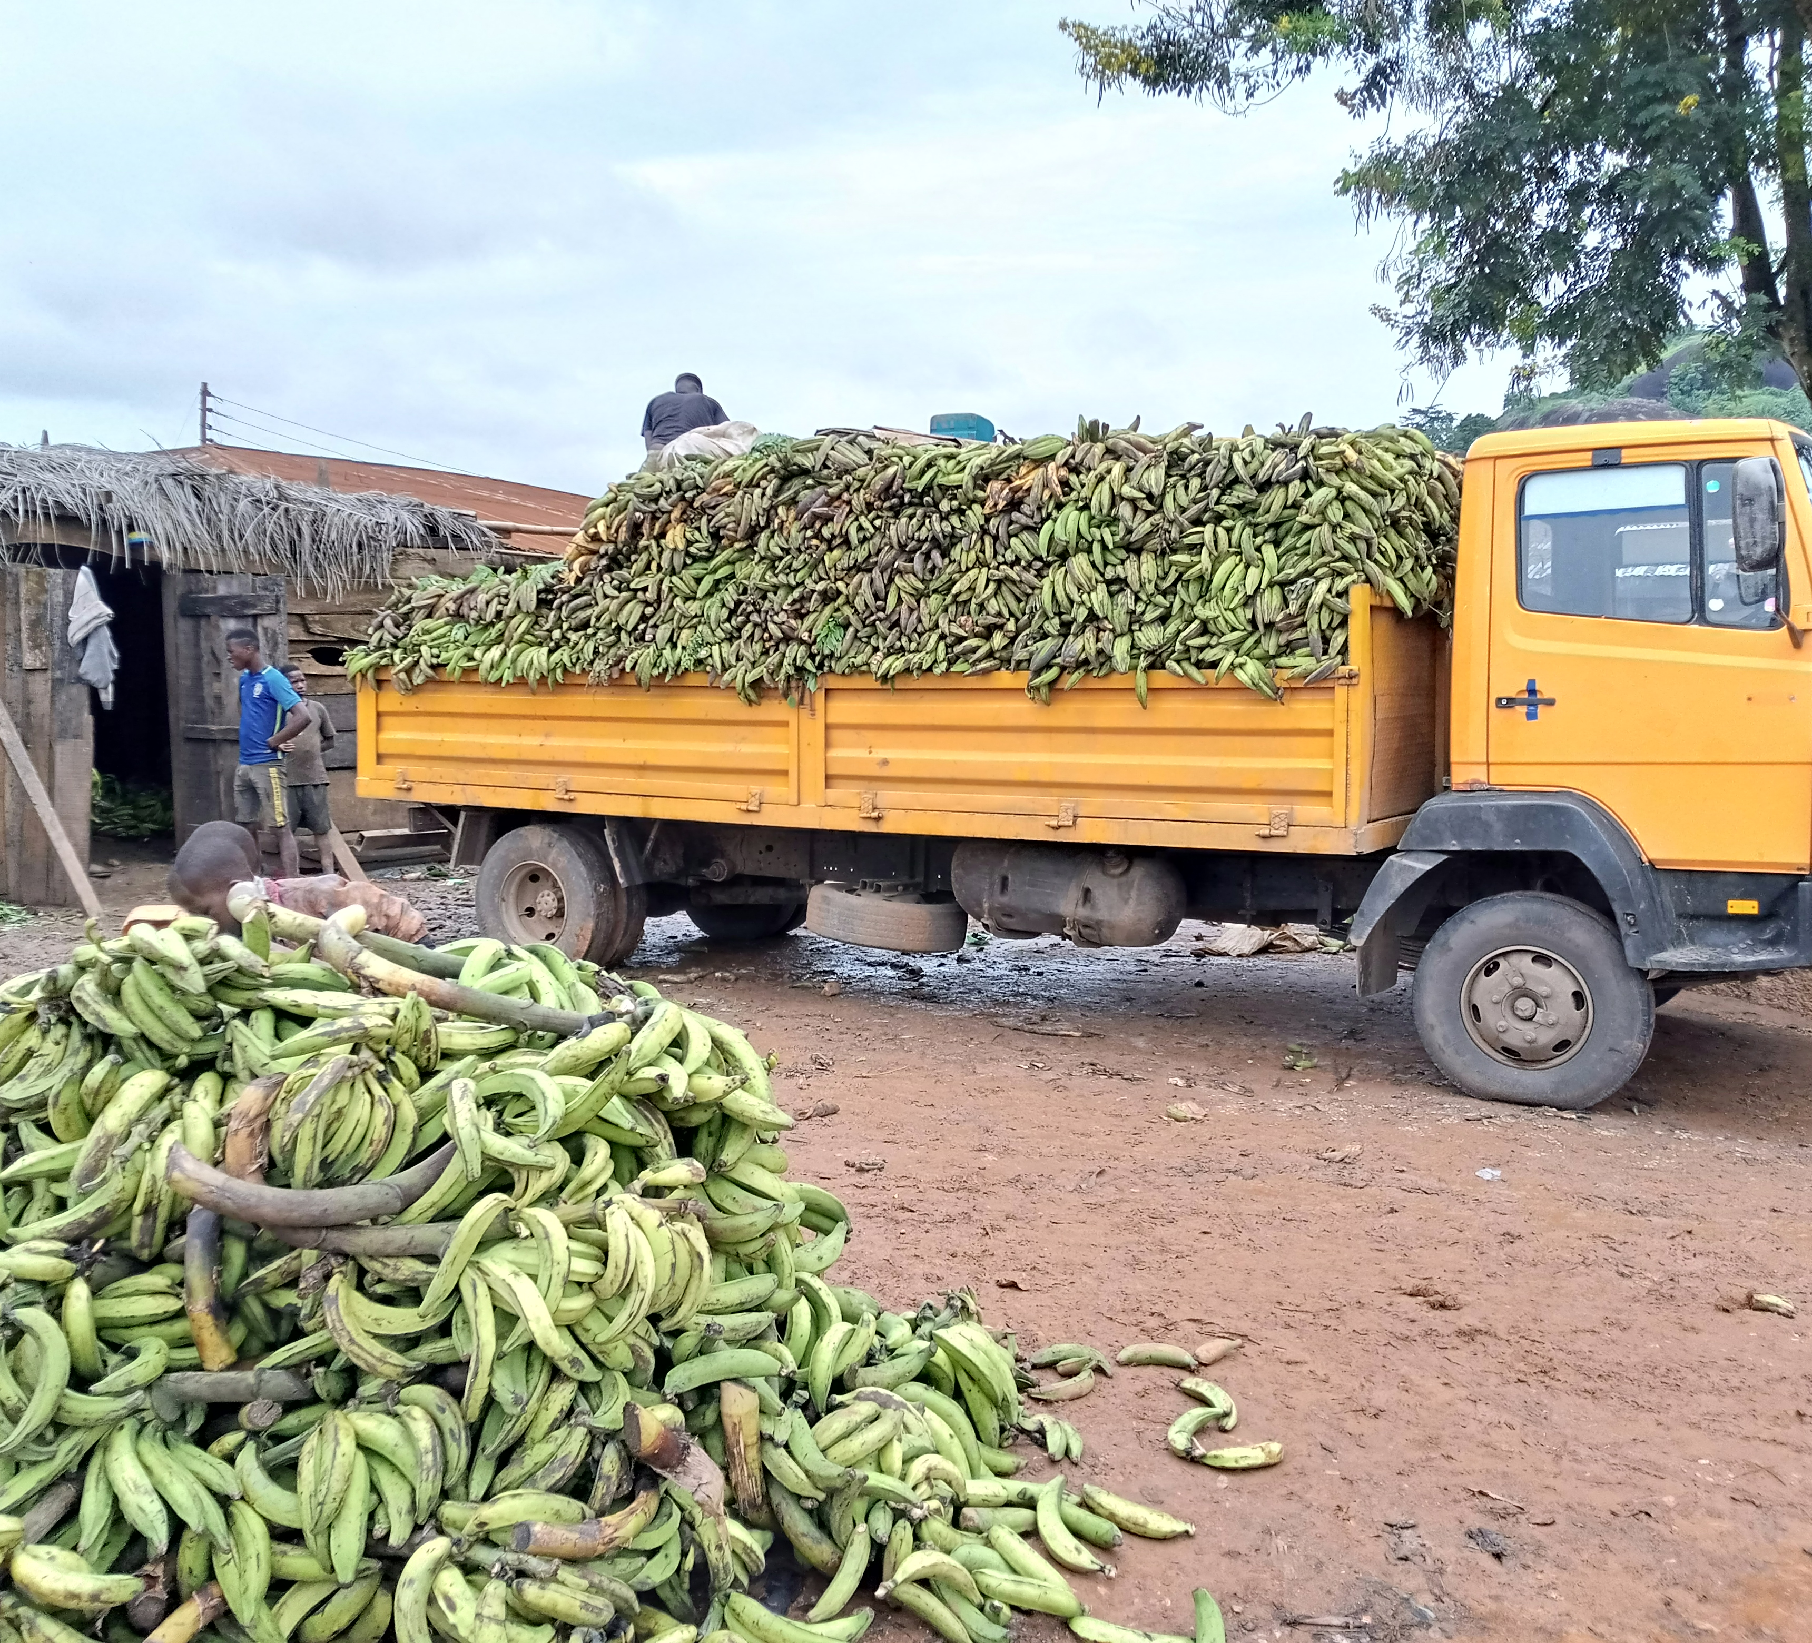
The PPP pillars are interwoven with the 3 core principles that are essential for the effective implementation of the 2SCALE approach.
The 3 Principles of the 2SCALE approach
Ownership: Competitive strategy depends on local champions who innovate and act to involve other actors and stakeholders in a coordinated strategy. Agribusiness development defies the notion of an external (and exclusive) ‘problem solver’! This approach supports local ownership by emphasizing Championship, Co-financing, Co-innovation, Co-investment, Communication, technical assistance and Organizational strengthening.
Empowerment: A major aim of the 2SCALE approach is to ensure the effective (more equal) participation of relatively vulnerable groups (smallholder farmers households, youth and women..). Their participation should result in an increased ability to raise their income and improve their livelihoods, not just for the duration of a project but well beyond.
Sustainability: Sustainability in agricultural and agribusiness development refers to the capacity of all actors and stakeholders involved to maintain competitiveness within their respective industries, without compromising the livelihoods of others working in the same target area or of future generations. In this regard, sustainability has three dimensions: economic, social and ecological or environmental.

Slide 17
Further Reading Materials
CHAPTER 3 and 6_Competitive Agricultural Systems and Enterprise_CASE approach
Module 1: Topic 2- How is 2SCALE Approach to Inclusive Business on 2SCALE Academy

Slide 18
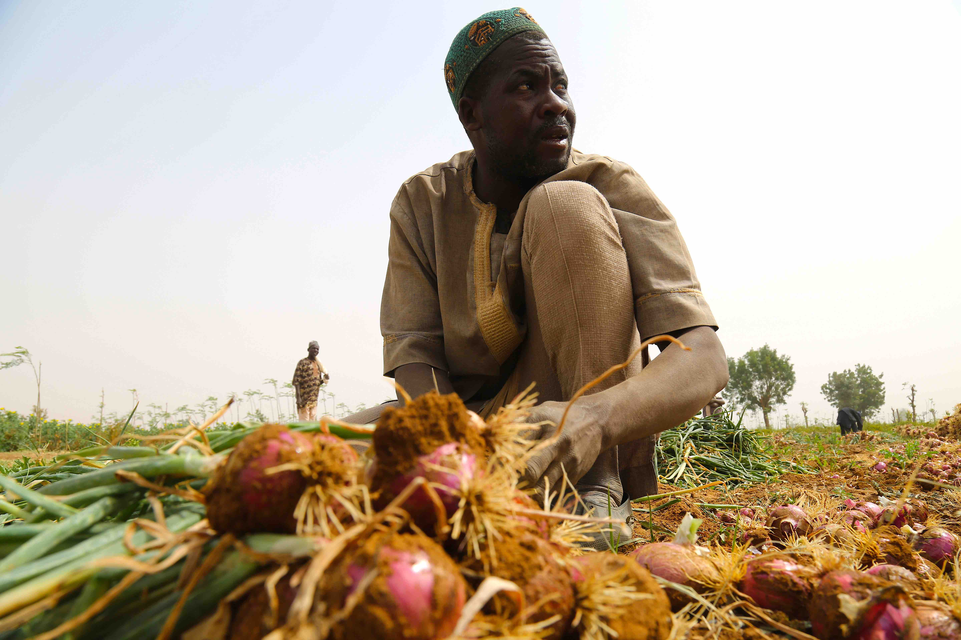
Session 3
Steps in setting up PPPs

Slide 19

The seven steps in developing and creating a PPP
Mobilization of business champions and inclusive business ideas.
Screening of business champions and of their inclusive business ideas; short-listing.
Development of a partnership brief and video-pitch of short-listed potential partners
(i.e. only those who passed the screening).
Selection of partnerships based on briefs and video-pitches - by the external Selection Committee.
Formalization of selected partnerships through a partnership agreement:
Diagnostic & Design (D&D) workshop(s) to develop a partnership theory of change, related monitoring and evaluation (M&E) system, and to agree on partnership structure, strategy, and priority interventions.
Writing of a partnership description and partnership agreement.
Quality assessment of the partnership description by the external Selection Committee.
Finalization of the partnership agreement, taking into account recommendations from the Selection Committee.
Notes:
The PPP protocol serves as guidelines for the 2SCALE team to identify and build partnerships. It covers steps 1 to 5 of partnership development and realization.
The implementation (step 6) and exiting (step 7) of PPPs are addressed in annual workplans, and partnership-specific action plans.

Slide 20
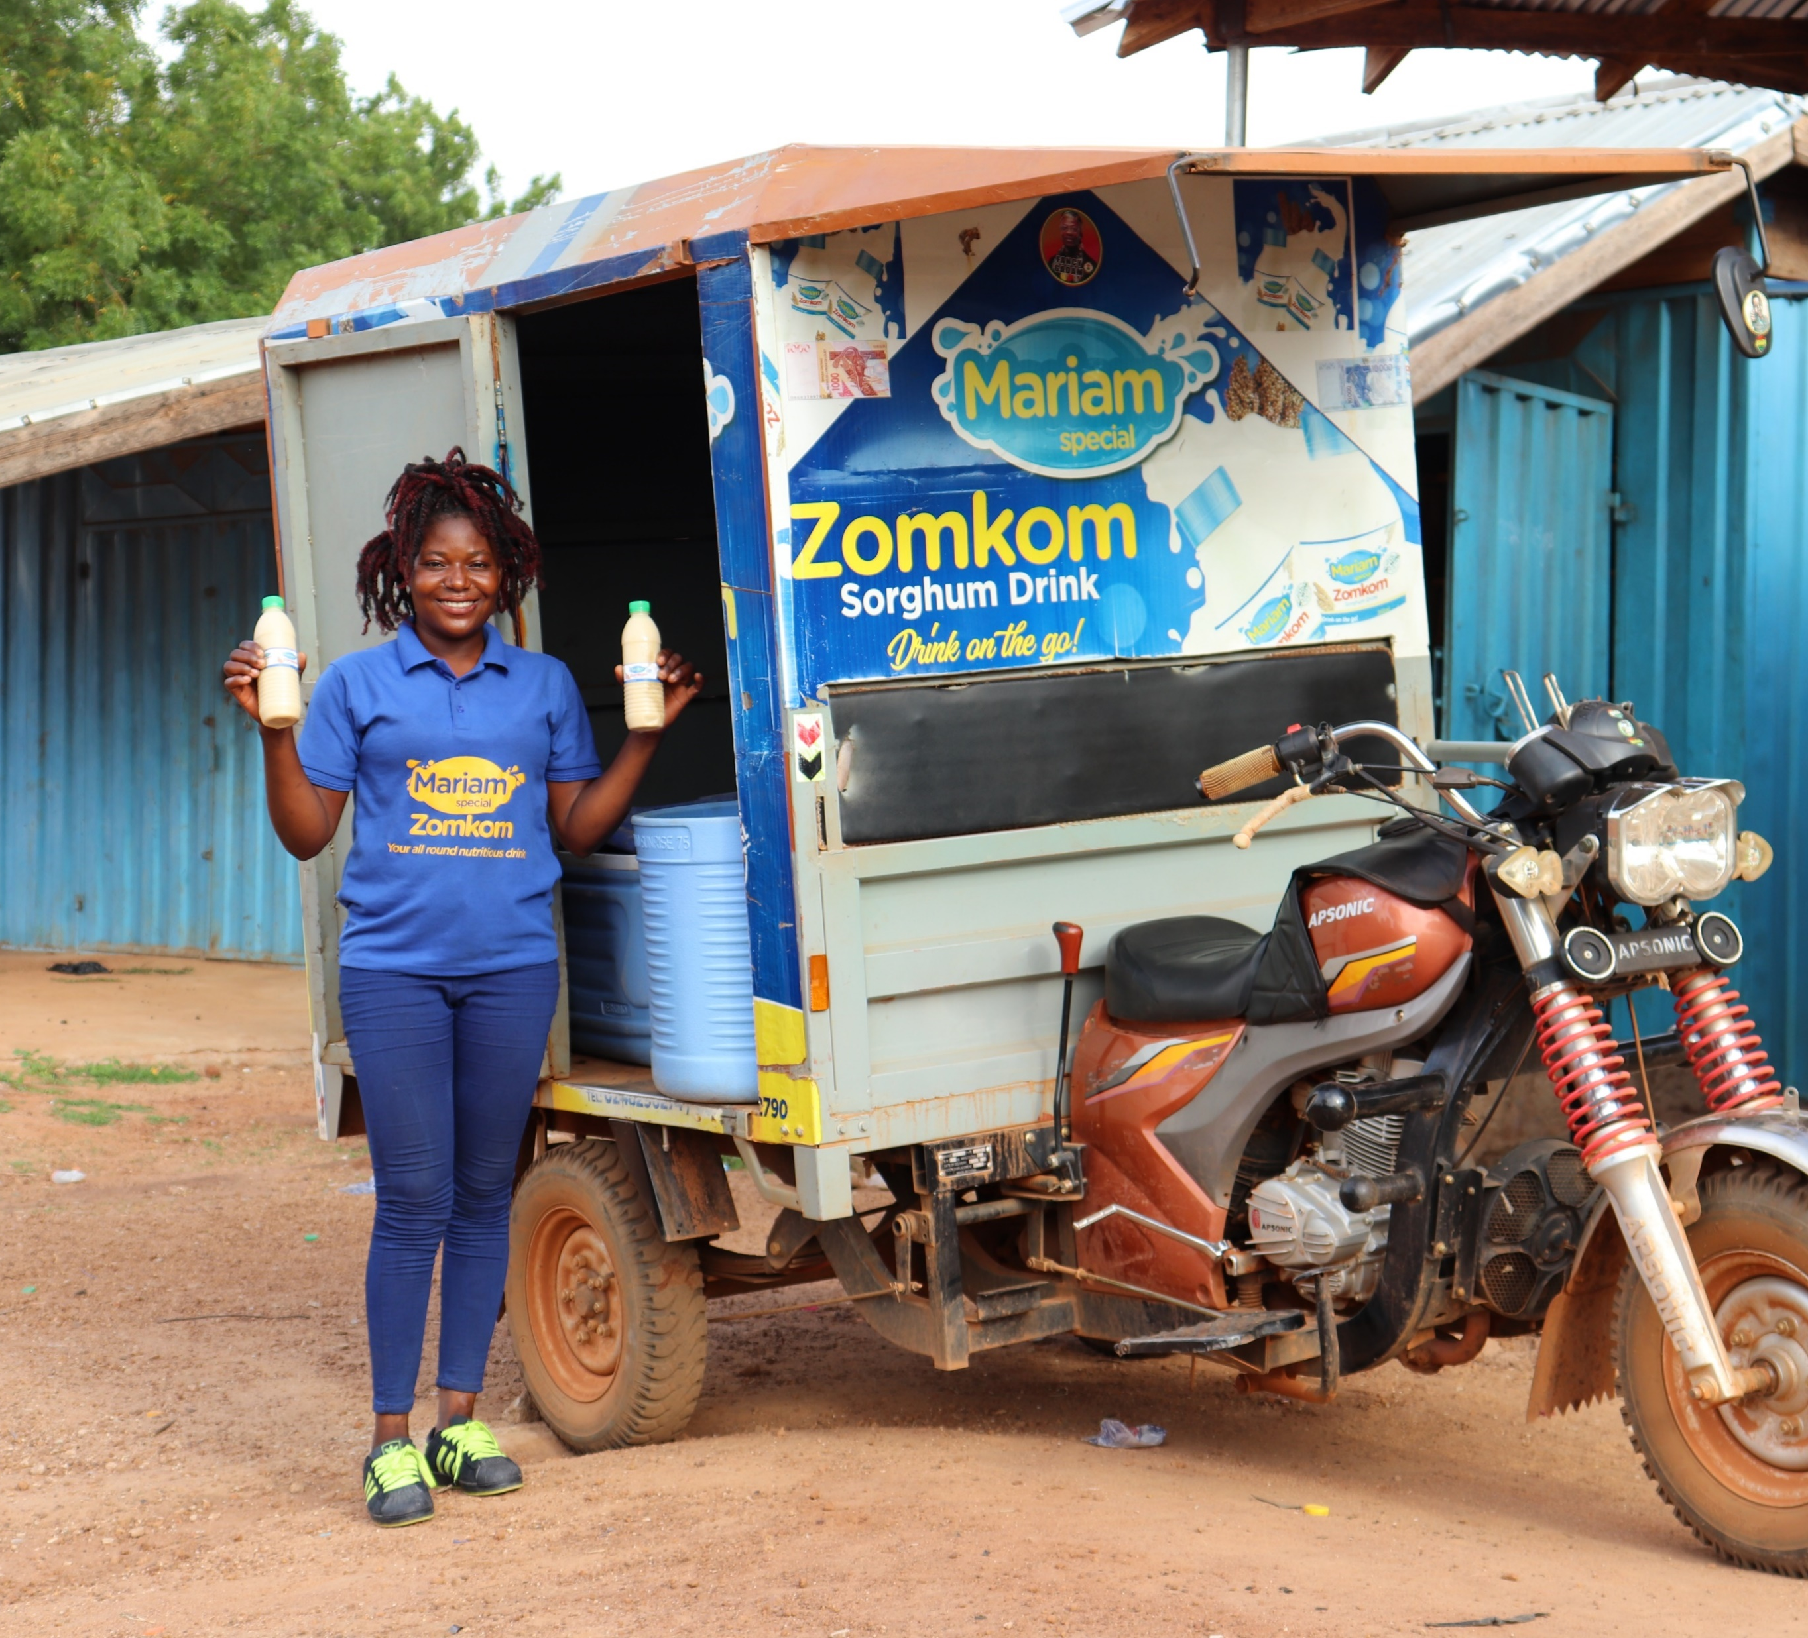
The seven steps in developing and realizing a PPP (Cont’d..)
Implementation of the partnership, including:
  Setting-up of governance structures.
  Action planning [yearly/ seasonal cycles].
  Execution of activities, including through support services, and reporting (also on financial contributions) [yearly/ seasonal cycles].
  Review of progress, monitoring & learning through governance mechanisms, and revision of action plans, including decision-making on continuing/ stopping the partnership and 2SCALE’s contribution [yearly/ seasonal cycles].
Design & implementation of an exit strategy for partnerships from which 2SCALE disengages (successful PPPs) or stops support (not successful PPPs), including end-of-partnership report.
Notes:
The PPP protocol serves as guidelines for the 2SCALE team to identify and build partnerships. It covers steps 1 to 5 of partnership development and realization.
The implementation (step 6) and exiting (step 7) of PPPs are addressed in annual workplans, and partnership-specific action plans.

Slide 21
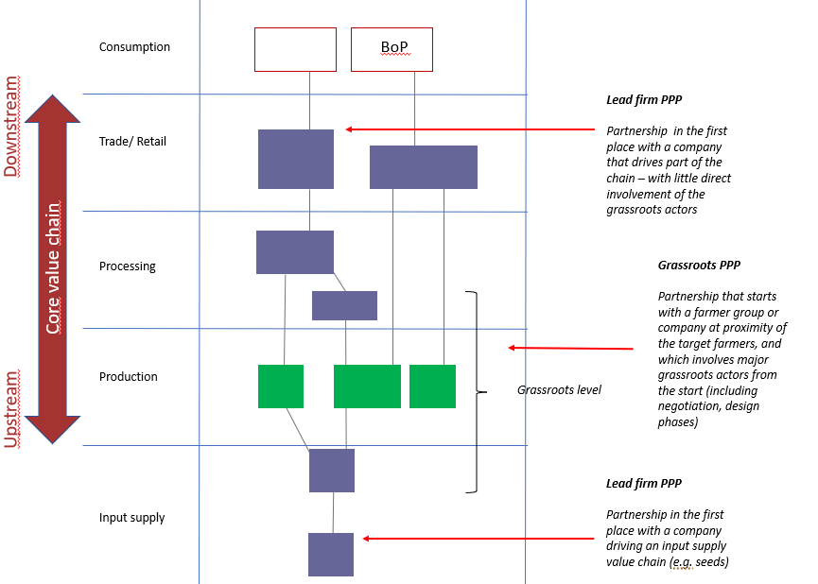
Archetypes PPPs
and entry points

Slide 22
Further Reading Materials
Module 1: Topic 3_How does 2SCALE partnership Cycle look like
2SCALE PPP_Protocol

Slide 23
Session 4
Key thematic areas needed for promoting inclusive agribusiness models

Slide 24
2SCALE's interventions supporting inclusive business in target value chain systems are organized in thematic areas. These 8 areas comprise aspects that are critical to the functioning of SMEs and can be linked to typical activities that partnerships implement. These thematic areas are:
2SCALE SERVICES ARE ORGANIZED IN 8 THEMATIC AREAS
BoP Marketing and Distribution (M&D)
Inclusive (green) Innovations
Agribusiness Cluster (ABC) formation
Supply chain coordination (SCC)
Private Sector Development (PSD) and entrepreneurship skills
Gender equality (GE) and Women Economic Empowerment (WEE)
Youth Inclusion
Financial Inclusion

Slide 25
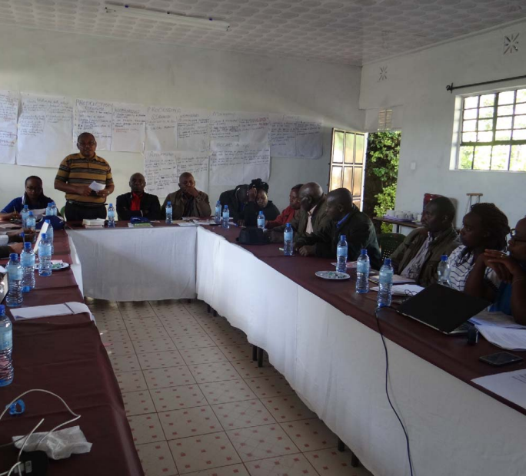
The essence of BoP M&D is to ultimately improve access to nutritious food for the BoP consumers in Africa. BoP consumers are characterized by their low income, form the largest consumer segment in Africa. Also, they are the most difficult segment to access. They represent an important market for food products.
Base of the Pyramid Marketing and Distribution (BoP M&D)
Typical 2SCALE activities within BoP M&D
Identifying BoP marketing opportunities
At this stage, the marketing and sales experts can help in identify opportunities in BoP markets by:
Focus areas: market size, client diversification, and cash flow.
Together with the Business Champion (BC), they assess the potential.
If viable, they co-create a strategy using tools like: Business Model Canvas (BMC) for a clear, one-page strategy. Other tools include: 3C model, Lean Canvas, VTDF model.
The Business Model Canvas (BMC) helps align or refine existing business plans to BoP market needs. Depending on the business stage, a full or partial BMC may be used.

Slide 26
Typical 2SCALE activities within BoP M&D (Cont’d..)
Appropriate branding and packaging
2SCALE supports Business Champions and micro-enterprises with branding & packaging (example, Guts Agro in Ethiopia develop Likie Mum cereal blends in enhanced low unit packs targeted at BoP consumers)
3. Facilitating market activations
2SCALE support business champions and micro-enterprises with market activations:
Enterprise level activations implemented by the Business Champion. This is a common activity supported in all BoP interventions in 2SCALE.
Activation by a contracted agency. This is common with BoP interventions in East Africa.
4. Facilitating last mile distribution
2SCALE supports business champions and micro-enterprises in last-mile distribution:
Piggybacking channel: The Yedent Agro “Koko” & Night tea model for example involved an indigenous partnership with local community porridge sellers.
Franchise model, where independent sales agents are used (i.e., Guts Agro Likie Mum, in Ethiopia).
Direct sales. Examples includes Mhogo, STAWI, and Tamanaa. This happens in most of the partnerships – either face-to-face or via social media/online.

Slide 27
Typical 2SCALE activities within BoP M&D (cont’d..)
5. Developing behavior change campaigns for healthier diets
2SCALE supports Business Champions and micro-enterprises with behavior change campaigns:
An example: behaviour changes in Fura drink preparation (hygiene) and mode of sales, using hand-held micro blenders with Fulani women in Northern Nigeria. A positive change in behaviour from Fura handling initially on the ground to adaptive behaviour from table. Apart from hygiene, it also ensured efficiency in terms of number of people served within a time period.
The use of early peer adopters and revered extension agent from Fulani communities as change agents after training impacted on the drivers of change.

Slide 28
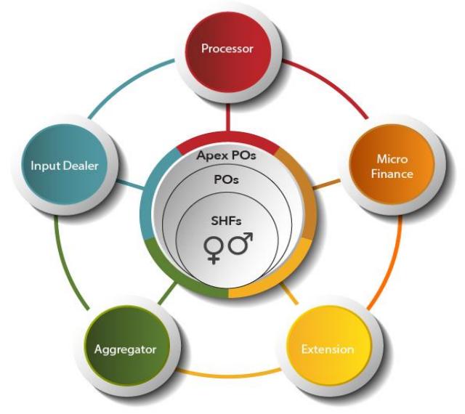
An agribusiness cluster (ABC) is a local network of agribusiness actors built around smallholder farmers. The ABC formation and development is about organizing and cementing the foundation for an efficient and functional value chains to emerge improving and sustain food and nutrition security, and employment.
Key characteristics of an ABC as one of the key pillars of 2SCALE approach include:
Agribusiness Cluster (ABC) Formation
It entails the forming and strengthening of local agribusiness actors
These actors are active in the same commodity value chain with a common vision-market
These actors are present in the same geographical location, which is key to establishing sustainable ABCs to foster engagement, co-innovation, co-learning and coordination in the value chain.
ABC approach is centered around smallholder farmers and their farming business
Building the linkages and capacities of these actors, creating and maintaining fair and win-win business relationships lays the foundation for sustainable clusters that relate to business champions to better coordinate the value chains. This fair and win-win connectedness will contribute to improved food availability and access.
Notes:
A robust value chain has a strong foundation in terms of efficient last-mile distribution of inputs for optimized productivity and has vibrant horizontal and vertical business linkages. Agribusiness cluster formation and development is about cementing the foundation for an efficient and functional value chains to improve food and nutrition security, and employment. Agribusiness cluster formation and development is one of the key pillars of 2SCALE inclusive and competitive agribusiness development at the grassroots level. It entails forming and strengthening local agribusiness actors’ networks. These actors’ are those who are working on the same commodity with common vision-market requirement in a specific geographical location. This geographical proximity of actors is key in forming sustainable agribusiness clusters for them to easily engage, learn and coordinate their actions. This approach centers on smallholder farmers' empowerment and their inclusion in the value chain.
An agribusiness cluster is a local network of agribusiness actors. Building the capacity of actors and creating and maintaining fair and win-win business relationships lays the foundation for sustainable clusters that are connected with business champions to better coordinate the value chain. This fair and win-win connectedness will contribute to improved food availability and access.

Slide 29
Improve farmers' (last mile) access to affordable agricultural inputs and services (technologies, market information, credit, agricultural advice, post-harvest management, storage, marketing) and strengthen their competitiveness and organizational capacity
Encourage coordination and joint action at the local level, so that different actors can co-invest and co-innovate, achieve economies of scale, reduce transaction costs, build trust and reduce the risks of individual members
Facilitate empowerment and give a voice to grassroots actors so that they can better negotiate during transactions through better access to information
1
Why ABC ?
There are three main reasons :
2
3

Slide 30
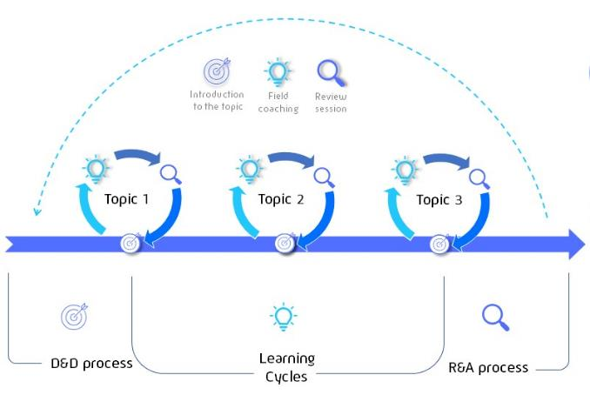
Key Activities under the ABC approach are
The formation of ABC starts during the building of inclusive agribusiness partnerships with private entrepreneurs.
Recruitment of ABC coaches and strategizing to sustain the coaching service.
Building the capacity of ABC coaches for them to facilitate, broker, and build the capacity of ABC actors.
Creating and maintaining business relationships among actors.
Our grassroots
empowerment approach

Slide 31
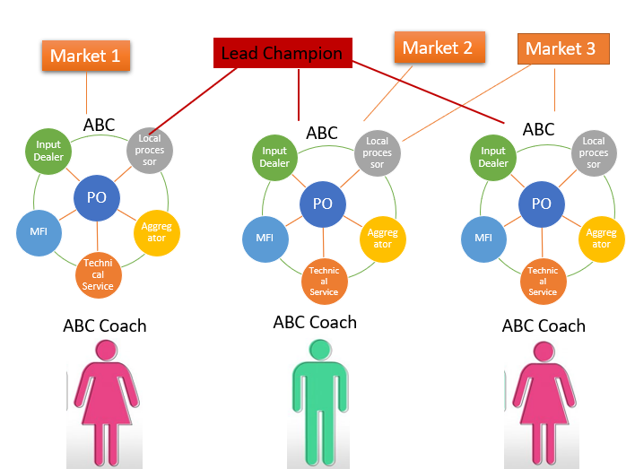
Roles of ABC coaches
Identify and facilitate business relationships
Network ABC actors and facilitate joint innovation
Strengthen the capacities of actors on "hard skills" and "soft skills"
Develop business plans
Negotiate prices and credits
Organize collective storage and marketing
Develop new products and brands
ABC Coaches from 3 ABC facilitate actors access to their respective markets but with priority to the Lead champion

Slide 32
start
Building a Solid ABC
Actor identification and profiling
Mapping of clusters
Scaling/replication
Depending on the context, it is necessary to:
Present the ABC approach to the business champion at the beginning of the process and have their buy-in;
Ensure the possibility of creating ABCs when selecting business ideas;
Map ABC potentials (potential number of farmers and other actors, geographic locations, ...) in the D&D course. Involve the BSS and the business champion if possible.
Conduct an assessment of the capacity building needs of ABCs. If possible, integrate evaluation into D&D.
Develop an annual action plan (AAP) that outlines interventions to address the capacity building needs of ABCs.
Sustainably phase out 2SCALE support
ABC needs analysis
Reflect and Adapt
Monitoring interventions and reporting
Joint intervention designing and implementation (AAPs & learning cycles)

Slide 33
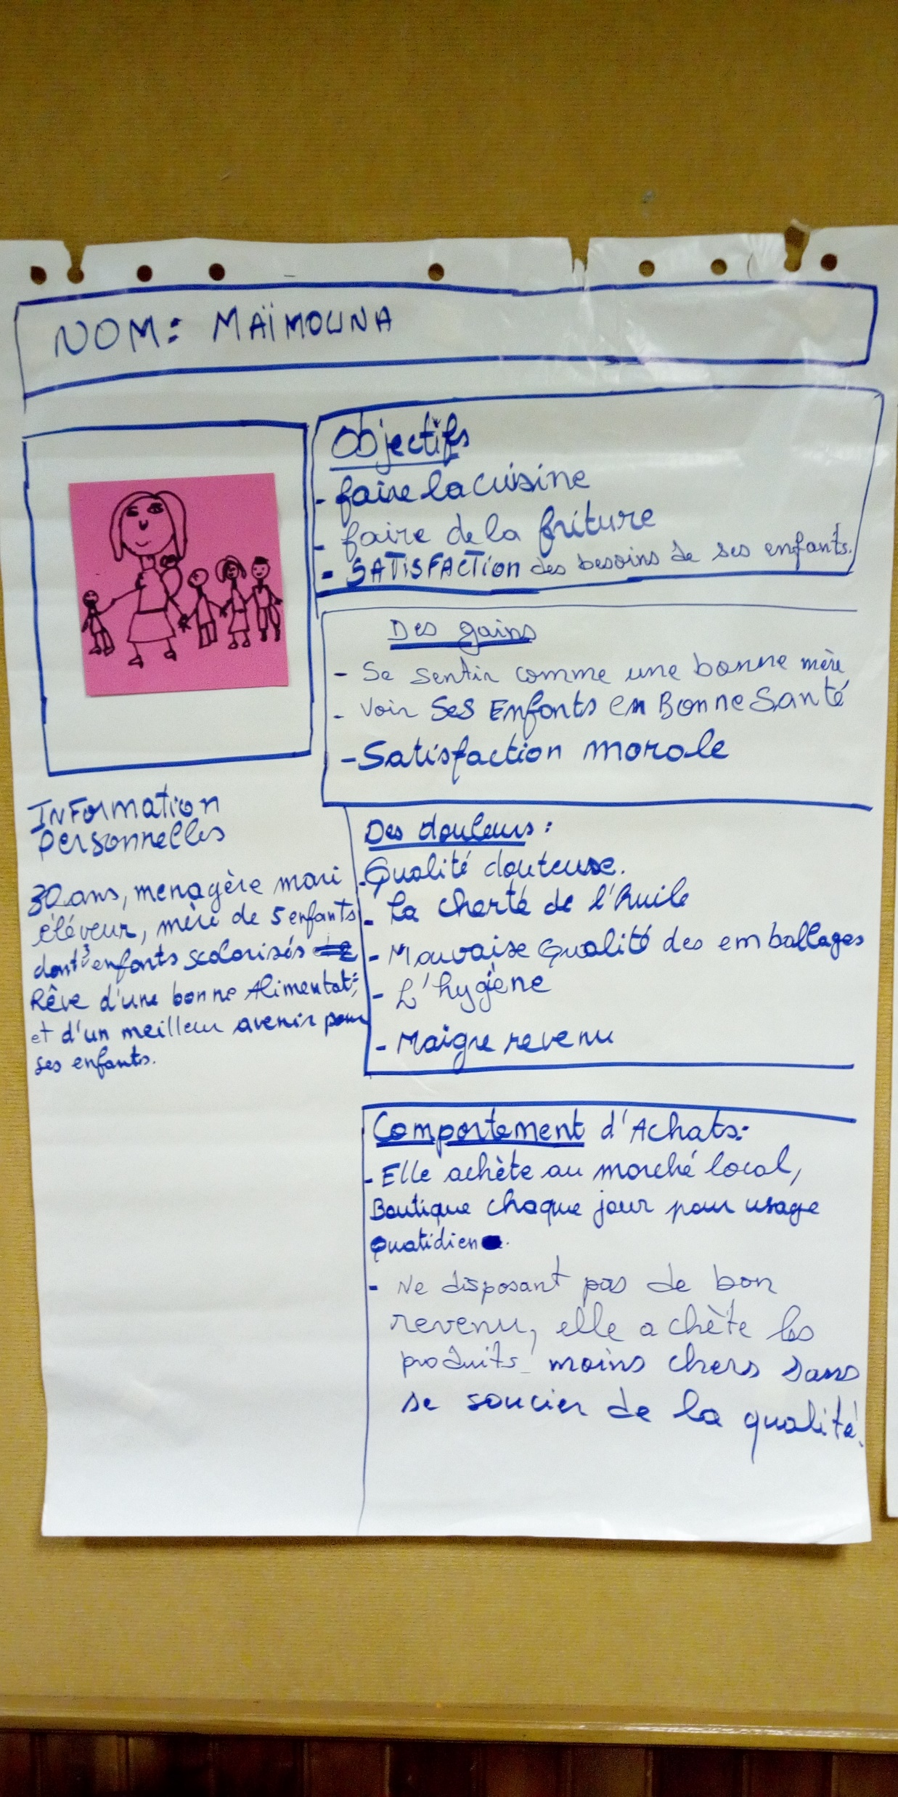
Building a Solid ABC (cont’d..)
Identify ABC coaches (with a focus on internal coaches) who will be involved in the implementation of the action plan.
Once the action plan is approved, implementation begins. A BSS is contracted for this purpose. Monitoring, data collection and reporting are conducted periodically to assess progress and make necessary adjustments.
At the end of the AAP cycle, a reflection and adaptation workshop is organized to take stock of the performance of the period and to propose new activities for the coming year. This cycle continues until the end of the partnership.
In the final year of the partnership, the phase-out strategy is fully implemented to ensure sustainability and strengthen the ABCs and its partnership.

Slide 34
Examples
Case of Dairy Products in Nigeria where a BSS coach is now part of the dairy industry. He collects and transports the milk to the collection centres using his personal car.
Case of pineapple in Benin: POs provide a commission on each kilogram of pineapple supplied to the processor to finance coaching costs\
Sustainability of coaching services
For sustainable ABCs, capable of providing adapted services, it is necessary to gradually consider the integration of coaching costs into the cost structure of the value chain.
The case of the maize PPP in Nigeria. The POs organize fertilizer orders and negotiate better prices while generating margins to finance coaching services.

Slide 35
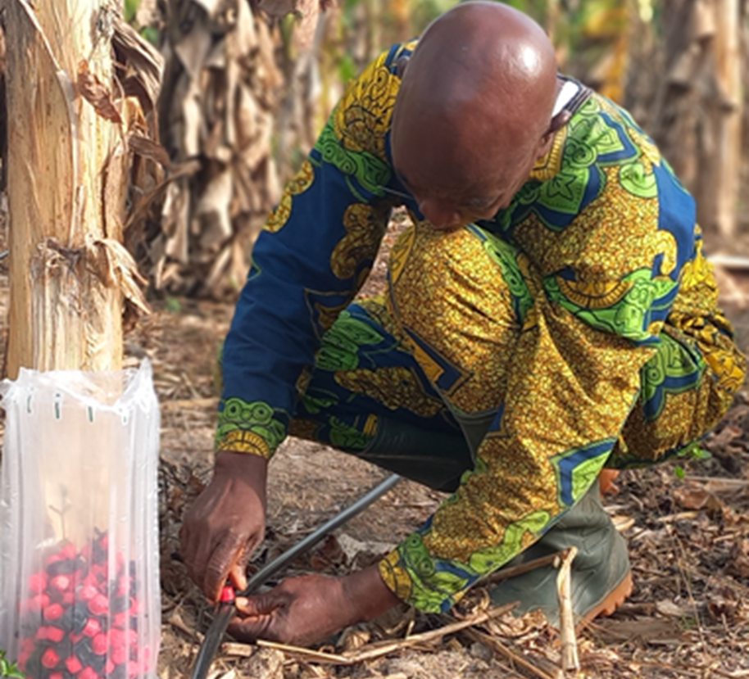
Inclusive (green) Innovation
The application of innovative products and services are essential in building resilient food systems in Sub Saharan Africa (SSA), where the majority food insecure people are located, and are projected to rise in the coming years. This is particularly more important with the changes in climate that expose farmers and food systems to significant risks, including weather, markets, and financial related risks
What is this thematic area about
1. Digitalization for Agriculture (D4Ag) focusing on Geodata for Agriculture and Water, (G4AW) that helps farmers and other value chain actors become more efficient through the use of ICT/mobile enabled solutions. Examples weather information with IGNITIA in Nigeria and Ghana and financial services with Doun-ka-fa company (Doni-Doni) in Mali.
2. Technical or Tangible (mechanical) Innovations such mechanical tools including Drones for filed operations and monitoring, Soya Kit to ease women processing of soya micro-processors reduce burden and cost when processing soya milk. Others include solar innovations, biodigesters for energy/fertilizer supply and refill for oil/milk dispensing.
3. Good Practices e include innovations that generally involve trainings, sensitizations, or collective action by value chain actors to improve coordination, farm productivity and timely access to services. Examples include use of improved seeds and planting products, coated/organic fertilizers and ISFM/IPM.

Slide 36

Our needs-based approach
Finding innovations
We search in our own networks
Innovators approach us
We organise innovation challenges
We collaborate with innovation support organisations (eg. tech hubs) and programs
Led by the 2SCALE
Innovation team
Identifying demand for innovations
We ask BCs to list innovation areas
We help orient PFs on innovations available
(eg. training workshops, our Digital Innovation Repository)
Working closely with the
2SCALE Partnership Facilitators
Innovation funnel
Partnership funnel
Carefully matching innovations with 2SCALE partnerships

Slide 37
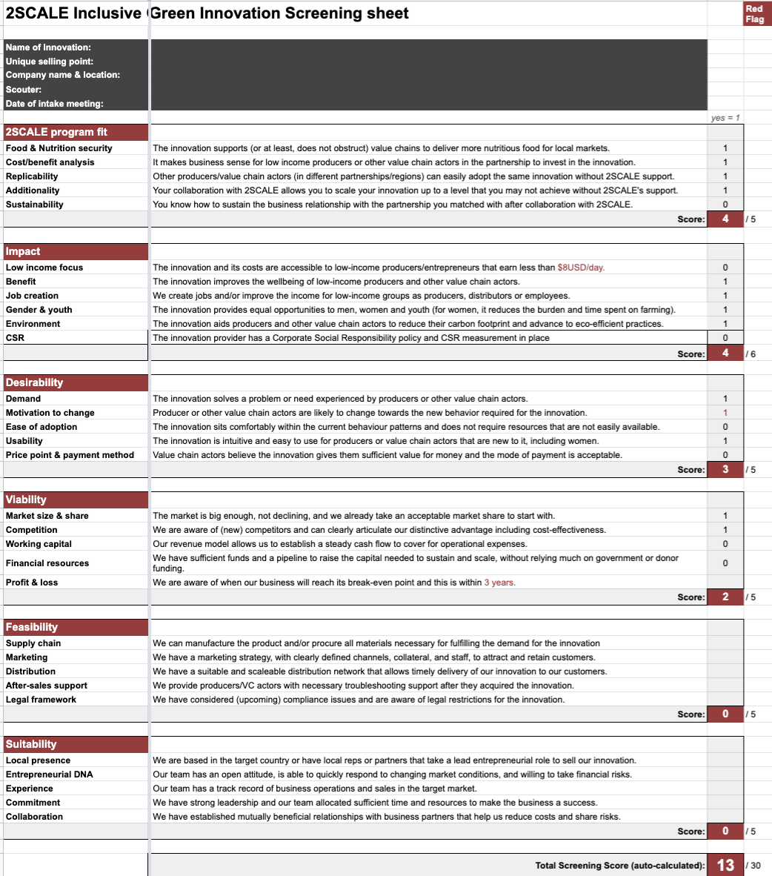
Innovation selection criteria
Program fit
Impact potential
Desirability
Viability
Feasibility
Suitability
Click to go to
our screening sheet template

Slide 38







Innovation areas to consider broadly (On and Off-farm)
Input level
Production level
Processing level
Marketing level
More efficient and eco-friendly use of water, energy and other inputs for production.
Less crop losses caused by climate change and extreme weather.
Better access
to finance, financial resilience and ability to save.
Less food losses in post-harvest handling, transport and storage.
More economic and nutritional value added with less waste, energy and cleaner resources.
Better farmer/market linkages, supply chain management, traceability and logistics.
Less packaging waste in distribution, retail and consumption.
Reach more BoP consumers at last-mile with nutritious food products that are aspirational and affordable.
Digital
innovation
Farmer advisory services
Mobile wallets, loans and insurance
Enterprise resource planning software
n/a
E-commerce
for BoP, farmer-market linkage software
Solar powered irrigation, drone spraying
Greenhouses, hydroponics
n/a
Solar powered cooling, moisture meters, improved storage
n/a
Mechanical
innovation
n/a
Refill solutions
n/a
Good practices
Seed varieties, cow breed, micro-dosing, crop rotation, inoculants, IPM
Drought tolerant varieties, climate tolerant breeds, salt resistant seeds
Financial literacy training
Circular products from food losses & by-products
n/a
Integrated sales optimization strategy
Processing of biofortified varieties
n/a

Slide 39

Supply Chain Coordination
What is this thematic area about
It is evident that value chains are about linkages and loose linkages, especially at the upper stream are the most pressing reasons for the low performance and functioning of value chains. Particularly vertical linkage of raw material supply is constrained by trust and transparency of benefit sharing. Hence, this thematic area deals with sourcing arrangements/vertical coordination among smallholder farmers and other actors sourcing raw materials. This emphasizes improving trust and transparency among actors for improved and coordinated business relationships.
Typical 2SCALE activities within supply chain coordination
1. Contracting: Facilitating context-specific contract agreements with clear and simple terms can improve the transparency of parties engaging in a contract. Hence, Inclusive Agribusiness Advisors can employ contract agreements to coordinate the supply chain and improve trust and transparency while being neutral in that agreement process.
2. Digital solutions: The utilization of digital solutions to improve transparency and mutually beneficial terms have been instrumental in coordinating value chains connected to SHFs. Businesses in the anticipation of long-term relationships invest in digital solutions. This solution serves to keep a record of who supplied what, when and from where, consistency and who gets how much from the final price.
3. Others include routine pricing negotiations using cost analysis and benchmarking, establishing premiums for quality and loyalty schemes

Slide 40
Private Sector Development (PSD) and Entrepreneurship Skills
All micro - and many small - and medium enterprises involved in inclusive agribusiness partnerships require support to fully tap into the business opportunities offered by their participation in the value chain. Private sector development and entrepreneurship tools and approaches help these businesses to connect, learn and grow. They also allow them to be competitive as they help to finetune their business plans.
What is this thematic area about?
The Aya trajectory for women micro/small entrepreneurs
Basic life and business skills training and coaching for youth
Business model canvas sessions for business champion
Others include collaborations with other programs such as GAIN Marketplace and Agritera to strengthen cooperative business approach
Typical 2SCALE tools developed or used for PSD

Slide 41
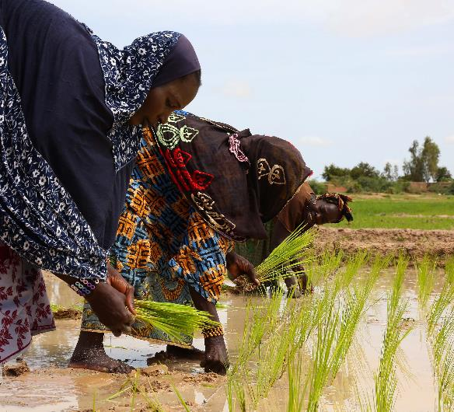
Concrete examples of activities in this area include the below. Integration of these activities depend on needs assessments.
Typical 2SCALE activities within PSD and entrepreneurship skills
Facilitation of contractual arrangements and vertical coordination: For example, the analysis of- and advice on contract types, options and building blocks (incentive structure, terms of inclusion, risks management, enforcement mechanisms).
Refining service provision models: For example, through value chain cost structure analysis (led by 2SCALE’s strategic partner: Financial Inclusion).
Facilitation of the introduction of innovations for chain efficiency: For example, introducing digital supply chain management systems and waste management technologies.
Strengthening entrepreneurship skills of partnering enterprises: Through 2SCALE’s Aya trajectory for women micro/small entrepreneurs, youth are empowered in their basic life and business skills through training and coaching.
Conducting gender and youth scans throughout the food value chain
Improving financial capabilities of Business champions

Slide 42
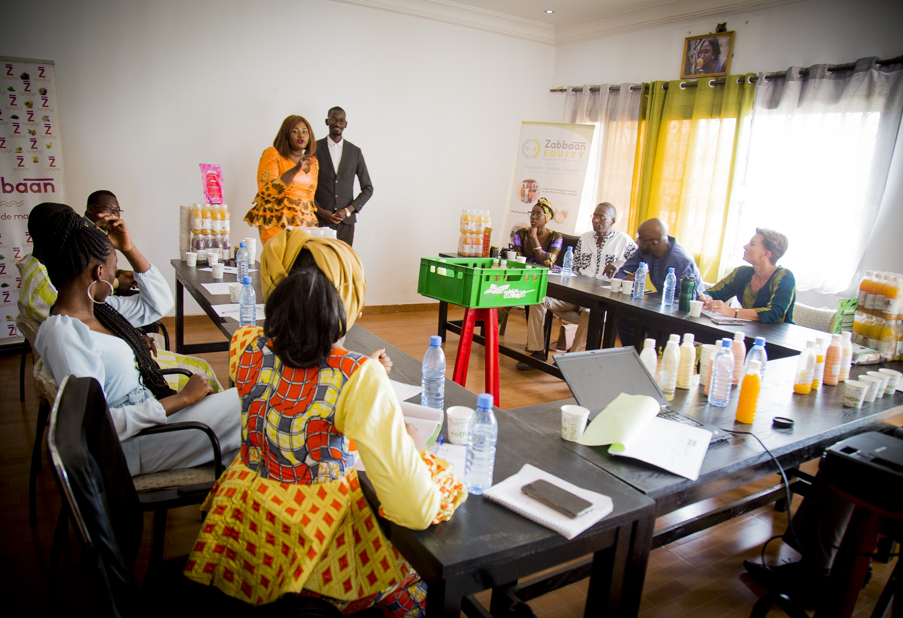
Gender Equality and Women Economic Empowerment (GE&WEE)
What is this thematic area about?
For equality to take place between genders and to get to more dynamic inclusive value chains, the gender equality and women economic empowerment thematic was set to facilitate good practices for facilitators and all actors to increase each other chances of doing business together as well as to diversify economic opportunities for all.
In that sense, 2SCALE’s gender equality objective is namely to support and help develop agribusiness models where women as smallholder farmers, processors, employees, traders, and entrepreneurs can equally:
have access to capacity building, support services, equipment, inputs, and assets for their endeavours.
benefit from the latter in the form of increased yields, incomes, time availability, new jobs, and market opportunities.
Make and /or influence decisions at household, agribusiness, cluster, or value chain levels.

Slide 43
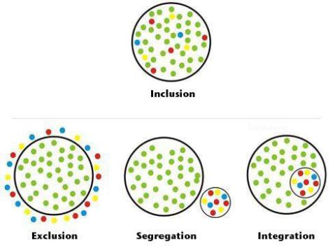
Typical 2SCALE activities within WEE
Ensure inclusion of women in private businesses and organizations (MSMEs, POs) with an overall range of 50% of women.
Foster access to productive resources (land, capital, inputs, time and labour-saving technologies, equipment...).
Strengthen gender-responsive services from private and public service providers (training, extension, coaching, equipment, finance...).
Improve women’s capacities to network, negotiate and establish relations using the AYA entrepreneurial tool (with peers, professional organizations, cluster level governance and in value chains).
Strengthen women’s ability to influence decisions, negotiate and control a fair share of the benefit accruing from their activity within the households and along the value chain

Slide 44
Youth Inclusion
What is this thematic area about
2SCALE adopted the Opportunities for Youth Employment model (OYE) developed by SNV. The model takes on a market-based approach which aims to prepare marginalized out-of-school youth for employment and entrepreneurship by equipping them with skills, and tools and linking them to networks that allow them to take up pathways for employment and entrepreneurship. This is aimed at sustainably reducing youth unemployment. OYE achieves this through:
providing training on market-relevant skills thus improving employability (push factors);
linking youth to market opportunities for employment and enterprise development, including access to finance (match factors) and supporting their access to employment opportunities or establishing youth-led enterprises in identified segments in the value chain through mentoring, coaching and leadership development (pull factors).

Slide 45
OYE Market scan to operationalize the OYE-model, the market scan result helps to identify youth profile, needs, and potential employment opportunities along the value chain.
Strengthen entrepreneurship skills of the partnering enterprises by providing training to ABC coaches and/BSS in ABCs to equipping them with necessary skills to ensure implementation of appropriate interventions.
Facilitate technical, market relevant and youth-friendly life and business development skills training for youth capacitating them on topics on social, business skills and leadership development targeting selected youth with ambitions for wage or self employment within targeted PPPs.
Pursue youth coaching and monitoring of partnering youth-led enterprises to a network of Agribusiness Cluster Coaches, Inclusive Agribusiness Advisors and other Business Champion delegated partners to ensure the performance and continuity of the created employment opportunity and youth-led businesses.
Typical 2SCALE activities within Youth Inclusion

Slide 46
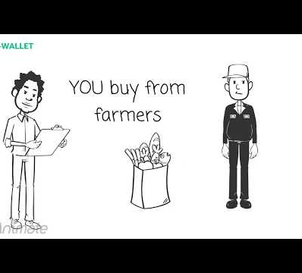
Financial inclusion – as a process – seeks to address the specific constraints that exclude people, such as the vulnerable, SHFs and their groups, women and youth from accessing, using, and benefiting from financial services. The 2SCALE project has been instrumental in ensuring that SMEs and smallholder farmers are in a position that ensured access and use of existing financial products and services or, in certain situations, improving them or coming up with new ones to fit the needs of farmers and SMEs.
Financial Inclusion
What is this thematic area about
Why Financial Inclusion is necessary
Access to finance helps businesses grow.
by enabling actors on both sides of the value chain to increase capacity
by expanding operations and creating new ones escaping the low input, low output circle
Access to finance can make value chains more efficient.
by bringing value chain actors together to better align their financial management, accumulate savings, etc
Access to finance for weaker groups (financial inclusion) creates a multiplier effect.
by improving knowledge about financial matters, households can also make better choices in household finances

Slide 47
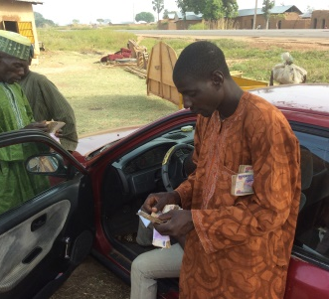
Typical 2SCALE activities within Financial Inclusion
Needs assessments and inventory of available financial services and products: This phase focuses on value chain actors’ financial needs, and the inventory of financial services and products available.
Matching demand and supply: This phase includes the linking of demand for and the supply of existing financial services of products, as well as the design of new financial instruments. In designing new or refining existing financial instruments, the focus should target the various actors in the value chain.
Implementation of the financial instruments: The newly developed financial instruments, which focus on business cycles and financial needs of targeted value chain actors, are piloted within a manageable timeframe and scope.
Evaluation and up scaling: Based on successful pilots, clients and financial service providers agree on how to scale up the financial services and products. This process involves rolling out capacity building approaches for reaching a large number of actors, development of local skills (training of trainers), enlarging financial networks, and setting up a monitoring and evaluation system

Slide 48
Further Reading Materials
Strategic Thematic Areas of 2SCALE
2SCALE Thematic Area Summary

